Slide 1
F2F Meeting
30-08-2024

Slide 2
Upstream Analysis
1. Quality control graphs of the scRNA-seq dataset
2. Clustered UMAP of the crypt enriched data
3. Clustered UMAP of the villus extract data
4. Heatmap of marker genes of each cell cluster
5. Clustered UMAP of enteroendocrine cells (Although this work might not make the final cut it demonstrates my ability to cluster and annotate certain aspects of the data. Maybe it can be apart of the appendix)
6. Stacked bar plots of the various cell types in CD vs HFHSD
7. Feature plot of marker genes for the various cell types

Slide 3
Downstream Analysis
8. KEGG enrichment pathway results (ridgeplots of log2FC values) SM- focus on enterocytes, ISCs and goblet cells (in that priority order)
9. GO term enrichment results (For the three GO term classes BP, MF, CC)
10. Specific KEGG pathway analyses (Heatmaps of gene expressions and corresponding KEGG Graphs as seen in the last two meetings).
N.B. Relevant pathways to focus on include lipid metabolism - PPAR/Glycolysis & glucogenesis and potentially oxidative phosphorylation; protein folding/degradation – proteasome, HSPs, ER; barrier function & tight junction proteins is your validation control of the intestinal epithelium based on previous reports. I suggest you also include inflammation pathways such as JAK/STAT, NFkB and cytokines to show that inflammation is very little associated with the epithelium in the diabetic mice (this can be added as appendix)

Slide 4
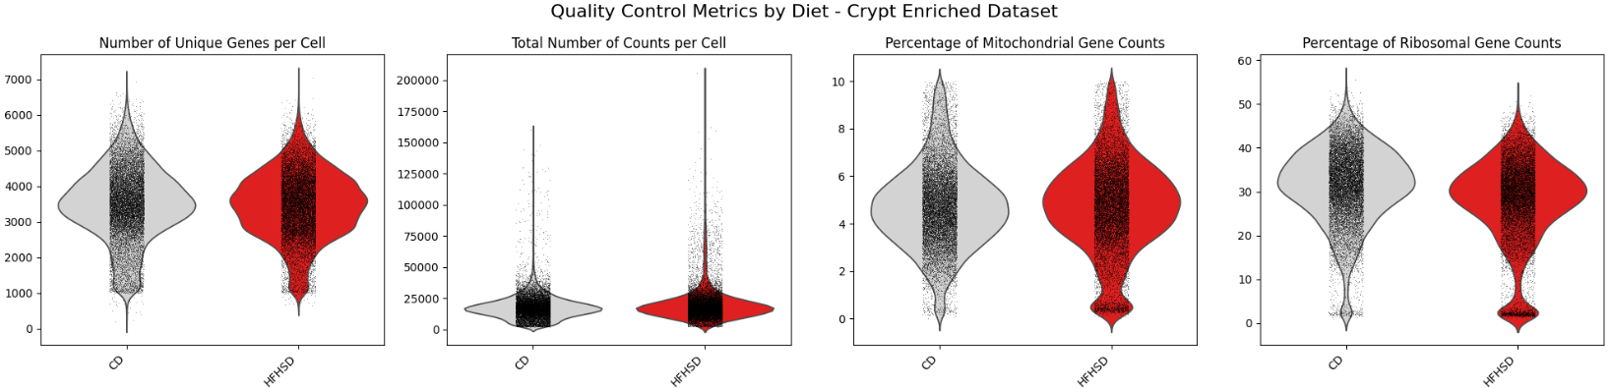
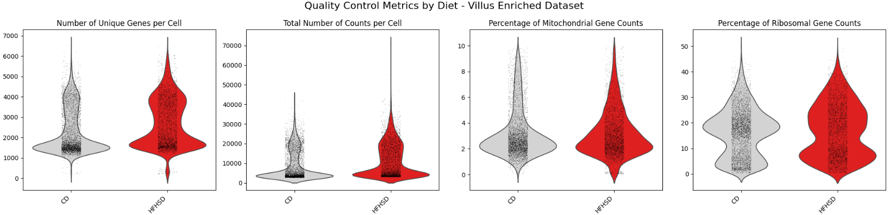
Quality Control

Slide 5
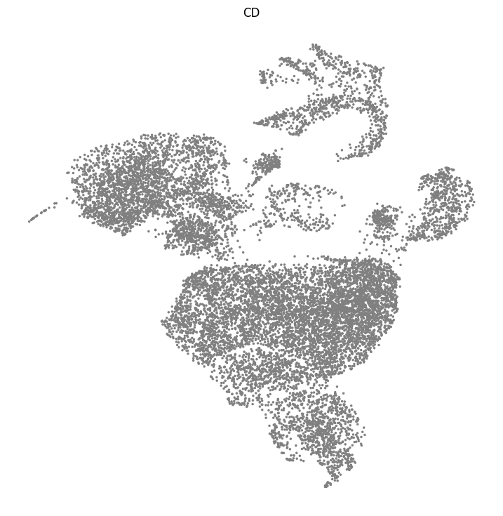
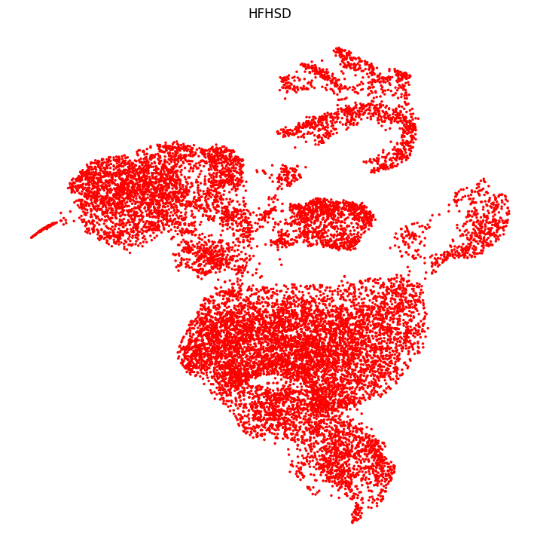
UMAP by Diet - Crypt Enriched Dataset

Slide 6
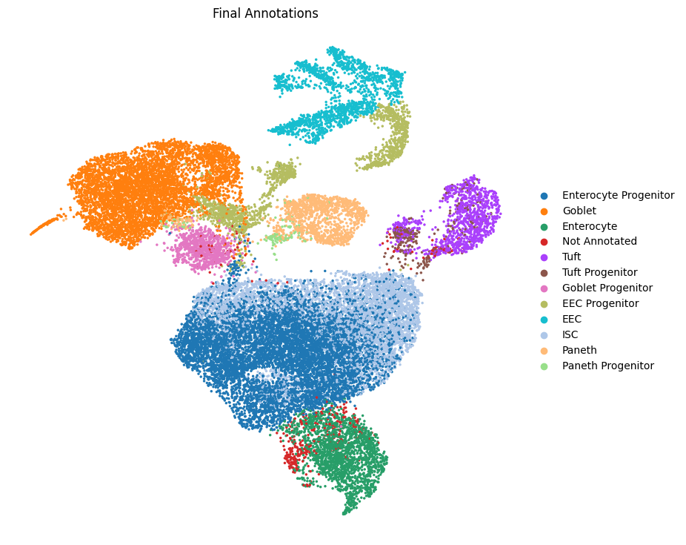
Clustered UMAP - Crypt Enriched Dataset

Slide 7
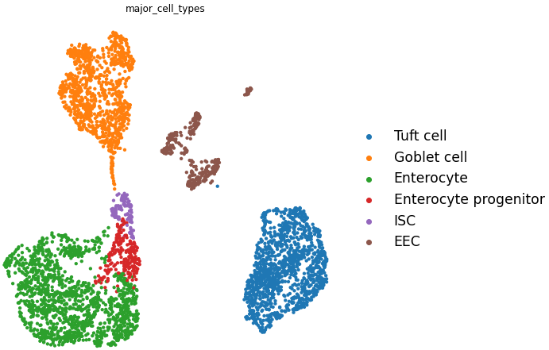
Clustered UMAP - Villus Enriched Dataset

Slide 8
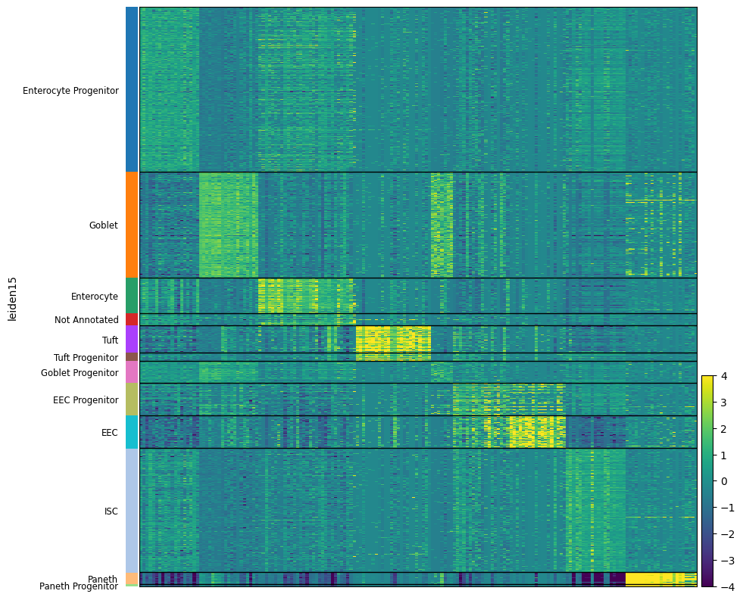
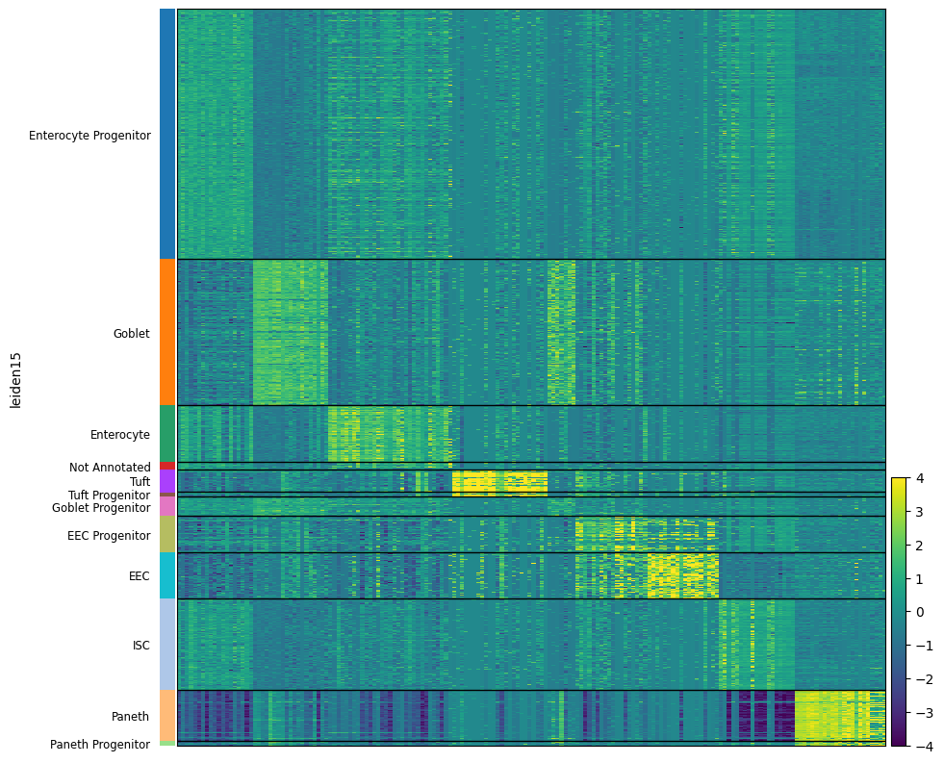
Heatmap of marker genes of each cell cluster
CD
HFHSD

Slide 9
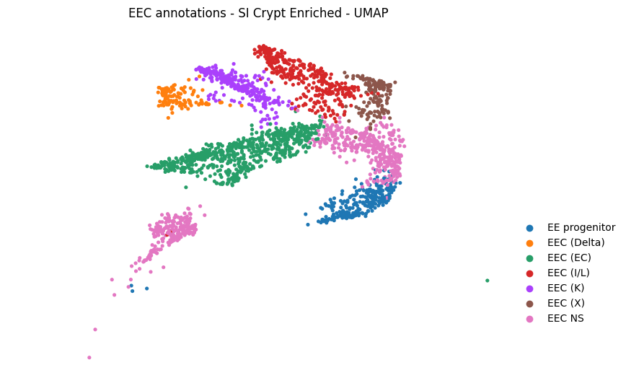
Clustered UMAP - Enteroendocrine Cells

Slide 10
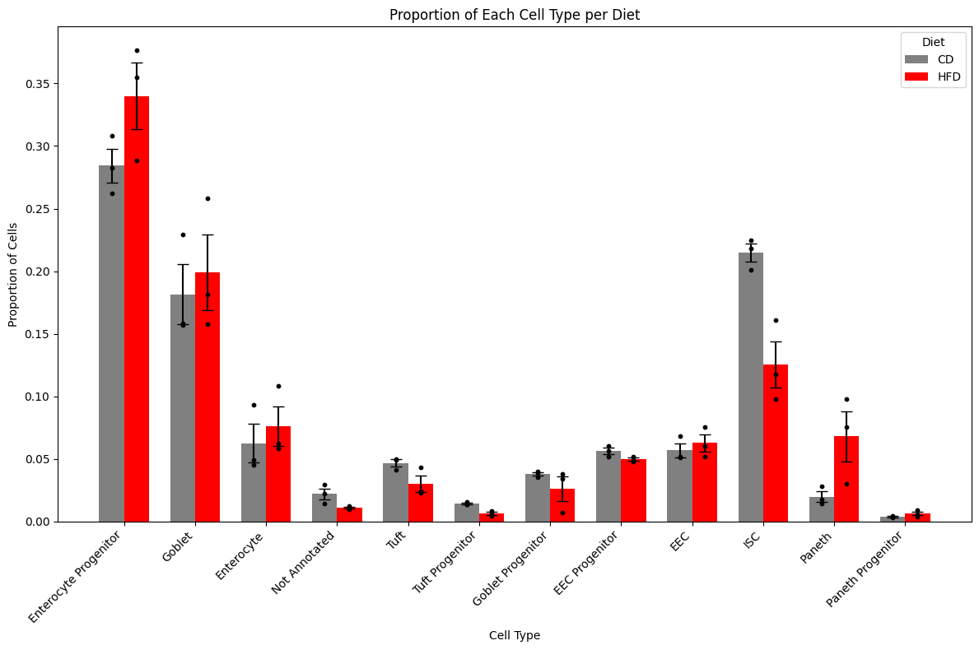
Cell Type Composition CD vs HFHSD

Slide 11
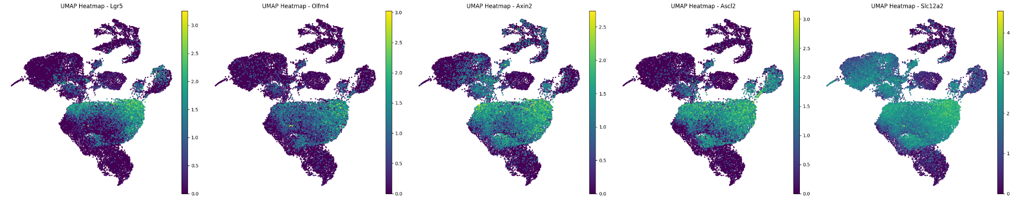
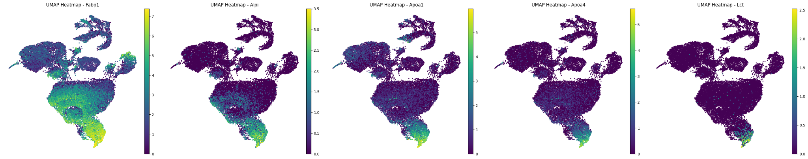
Feature plot - Marker Genes of Various Cell Types
Intestinal Stem Cell Marker Genes
Enterocyte Marker Genes

Slide 12
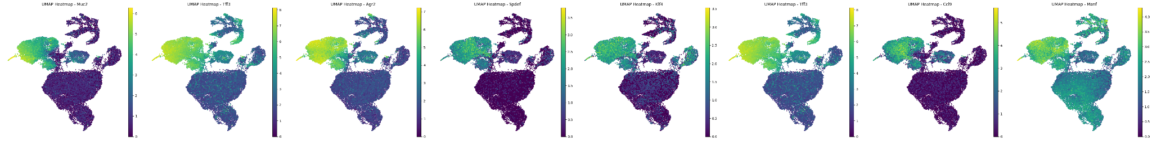
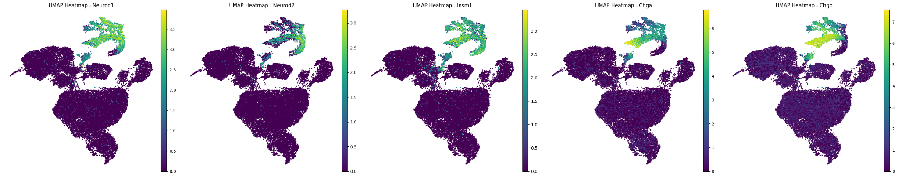
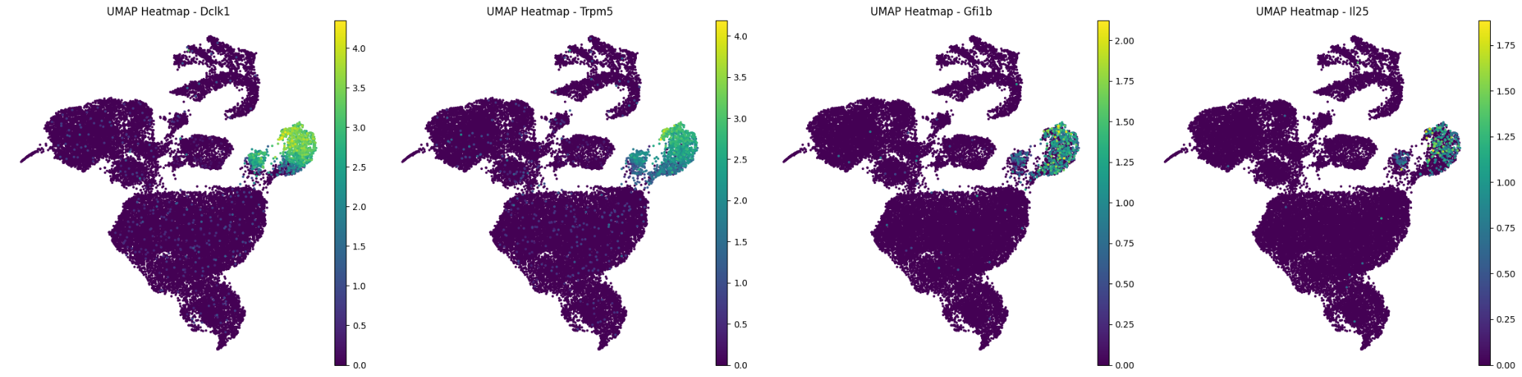
Feature plot - Marker Genes of Various Cell Types
Goblet Cell
EEC
Tuft Cell

Slide 13
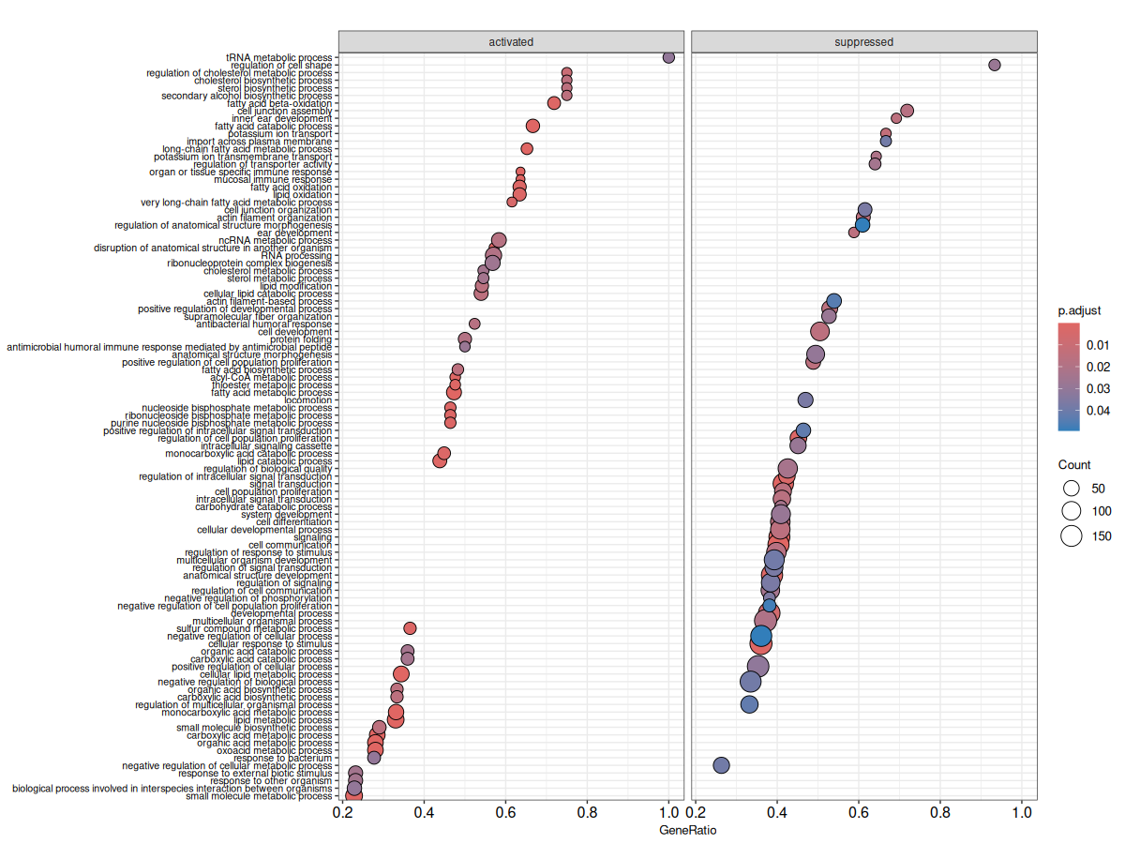
Gene Ontology Enrichment Analysis - ENT BP

Slide 14
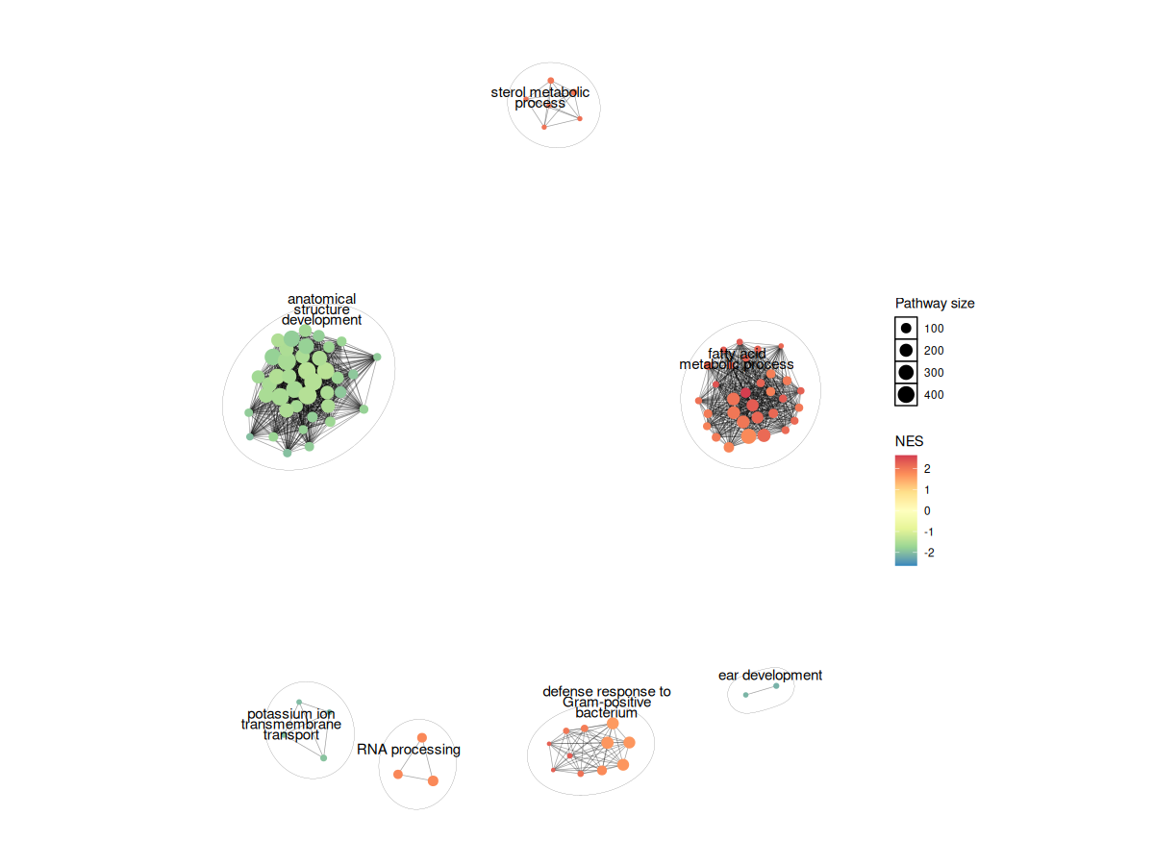
Gene Ontology Enrichment Analysis - ENT BP

Slide 15
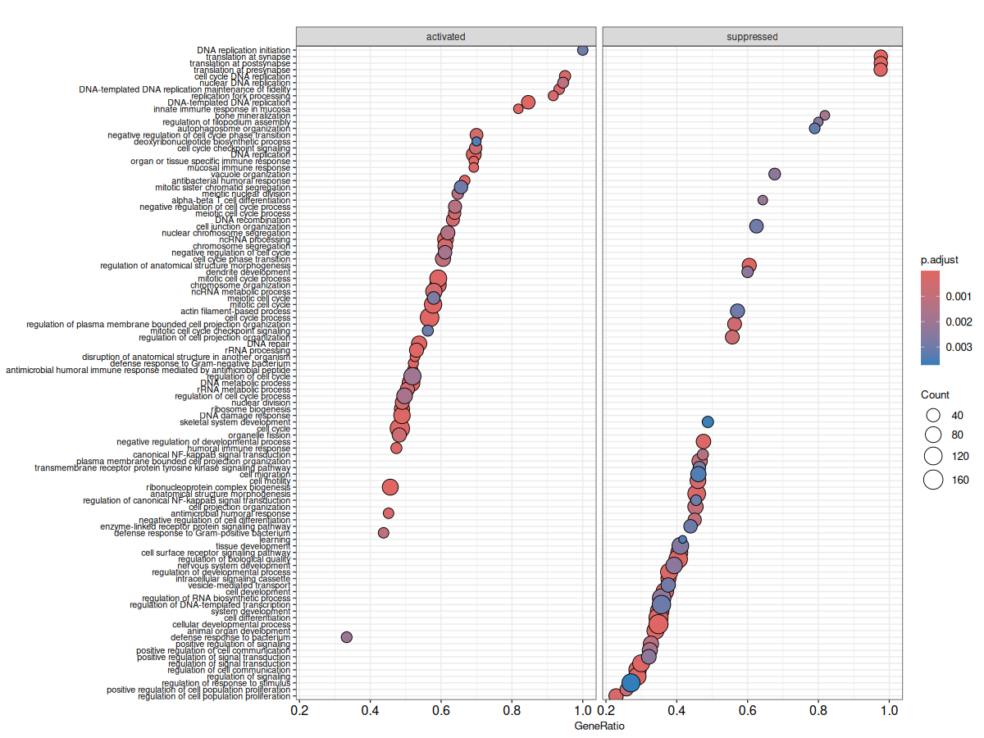
Gene Ontology Enrichment Analysis - ISC BP

Slide 16
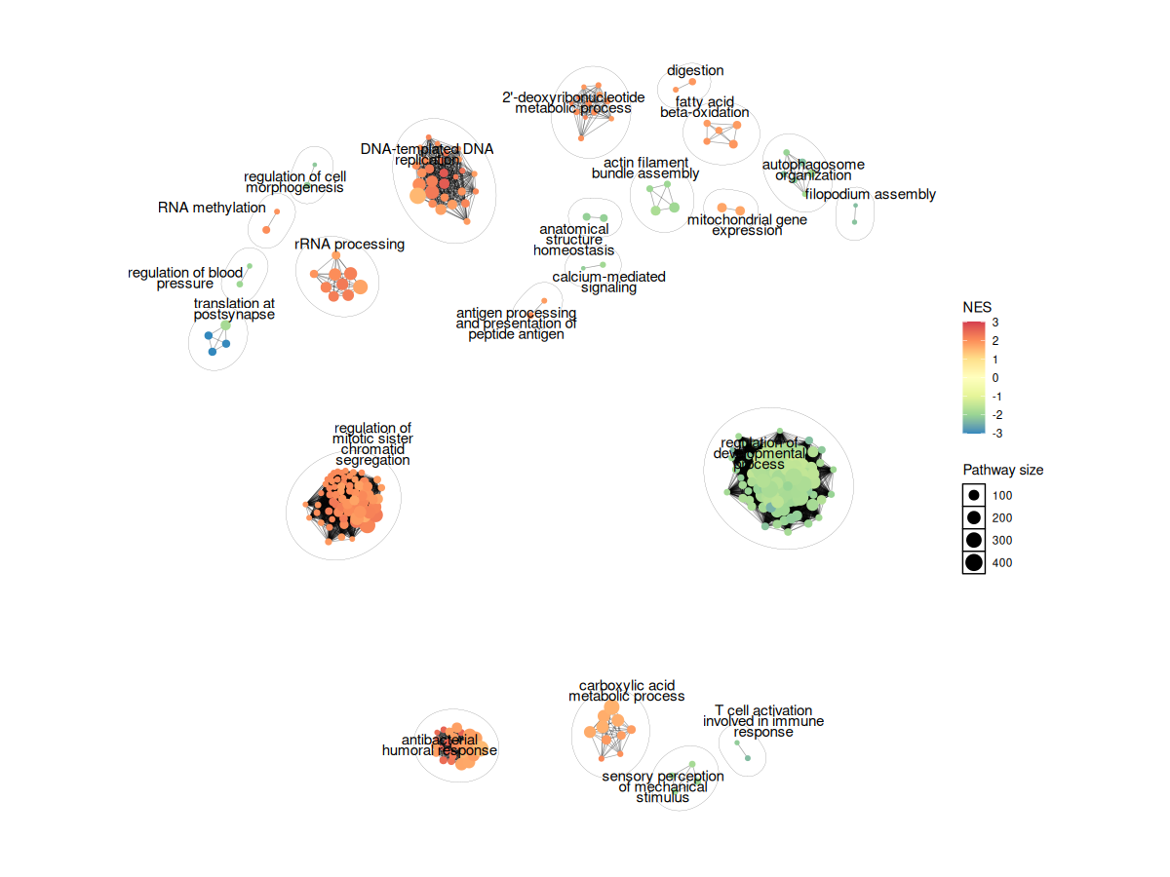
Gene Ontology Enrichment Analysis - ISC BP

Slide 17
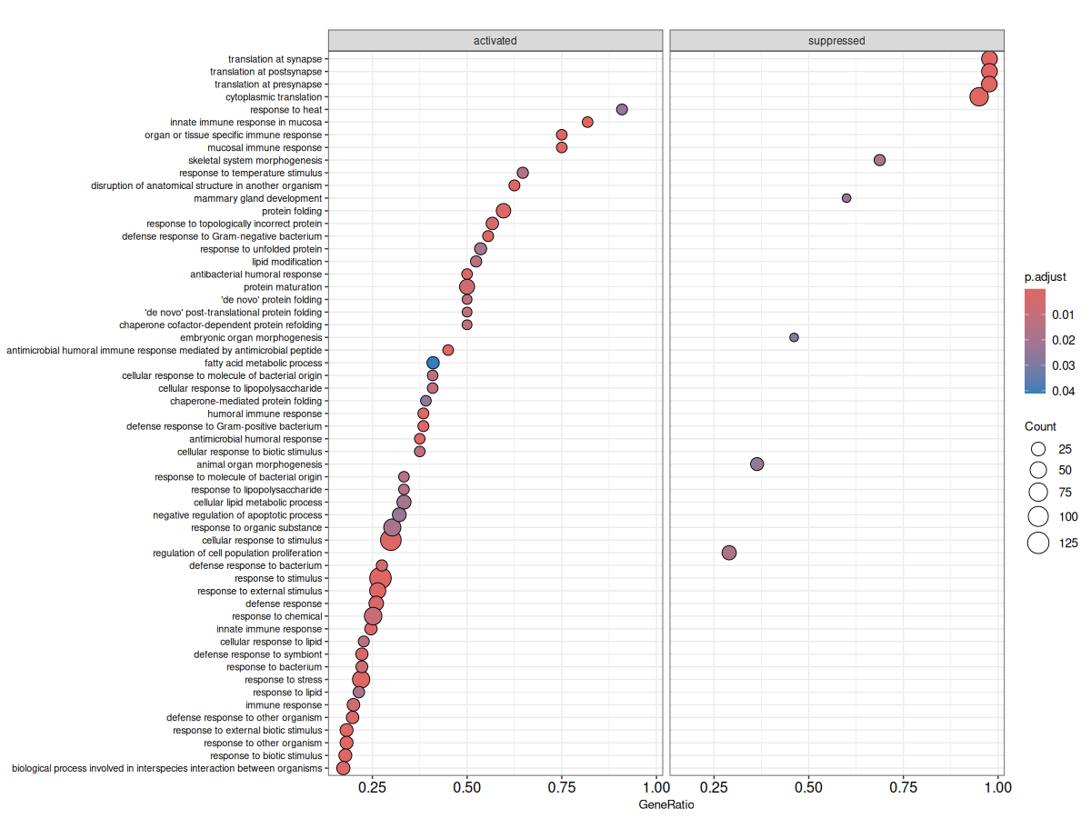
Gene Ontology Enrichment Analysis - ISC BP

Slide 18
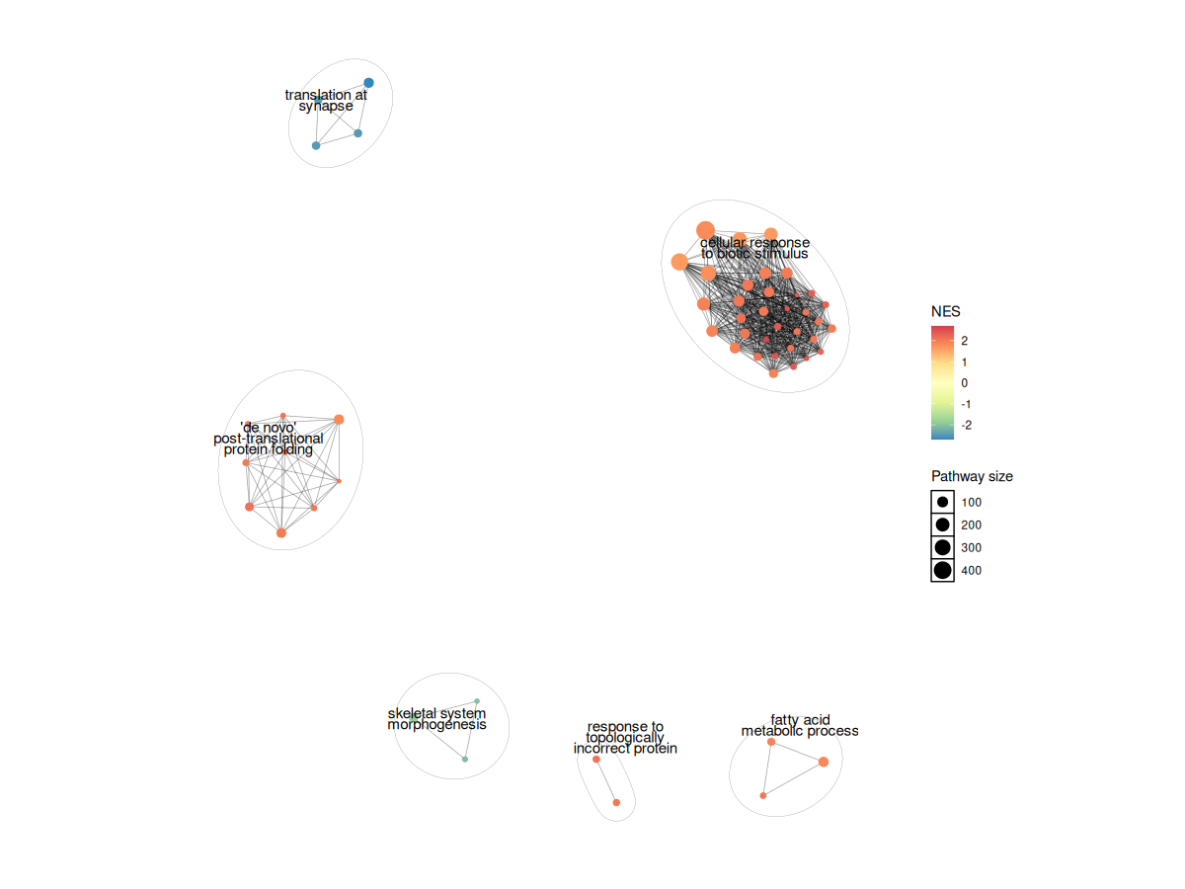
Gene Ontology Enrichment Analysis - GOB - BP

Slide 19
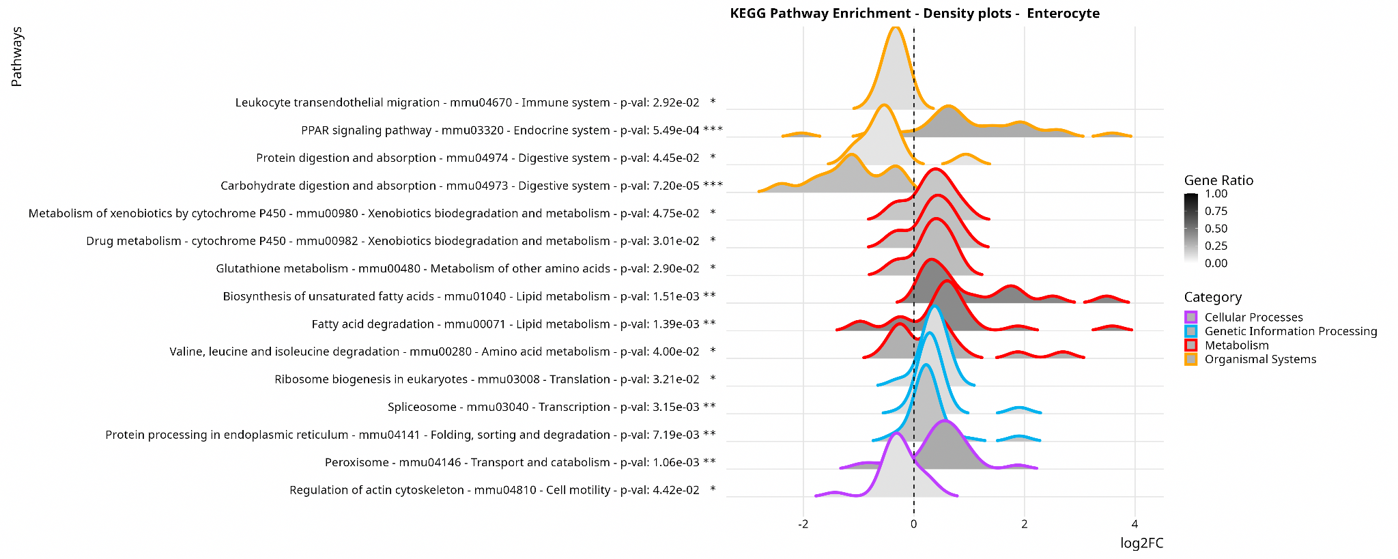

Slide 20
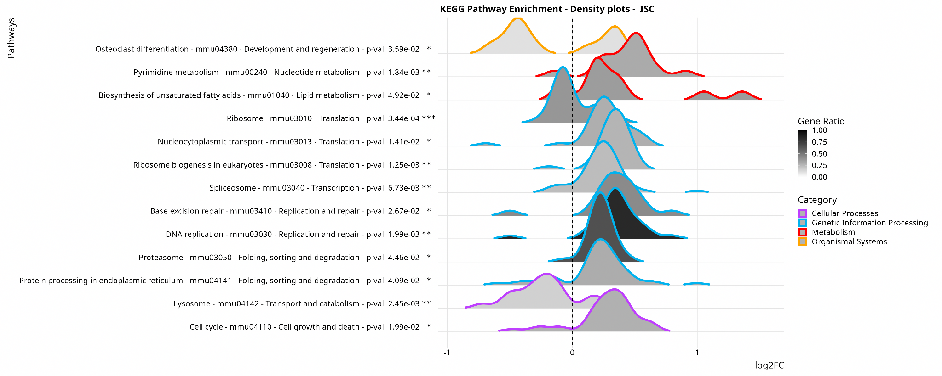

Slide 21
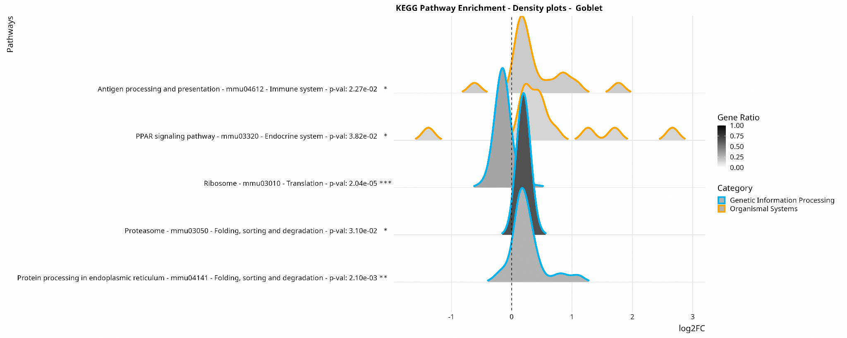

Slide 22
Enterocyte Cell Pathway Analysis

Slide 23
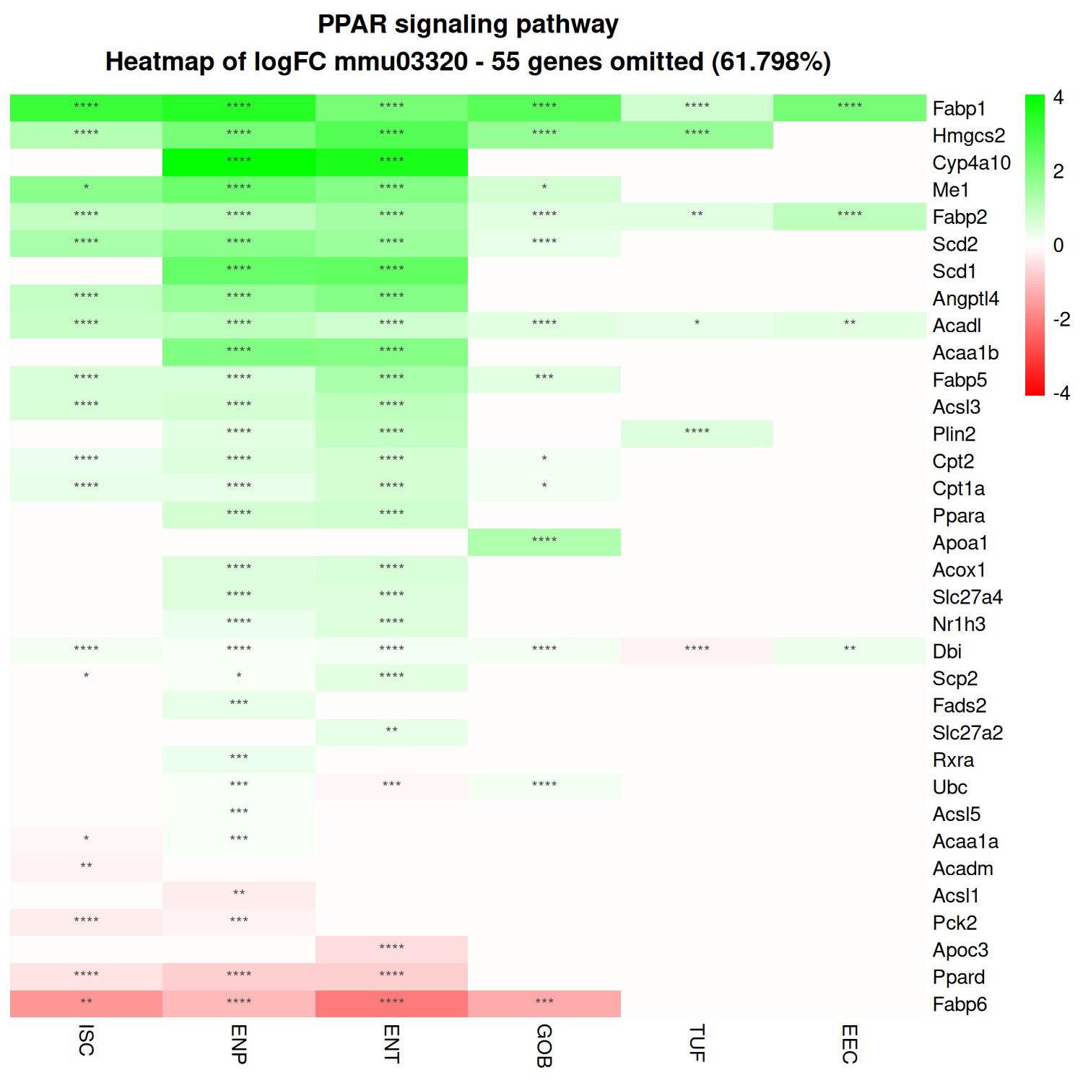
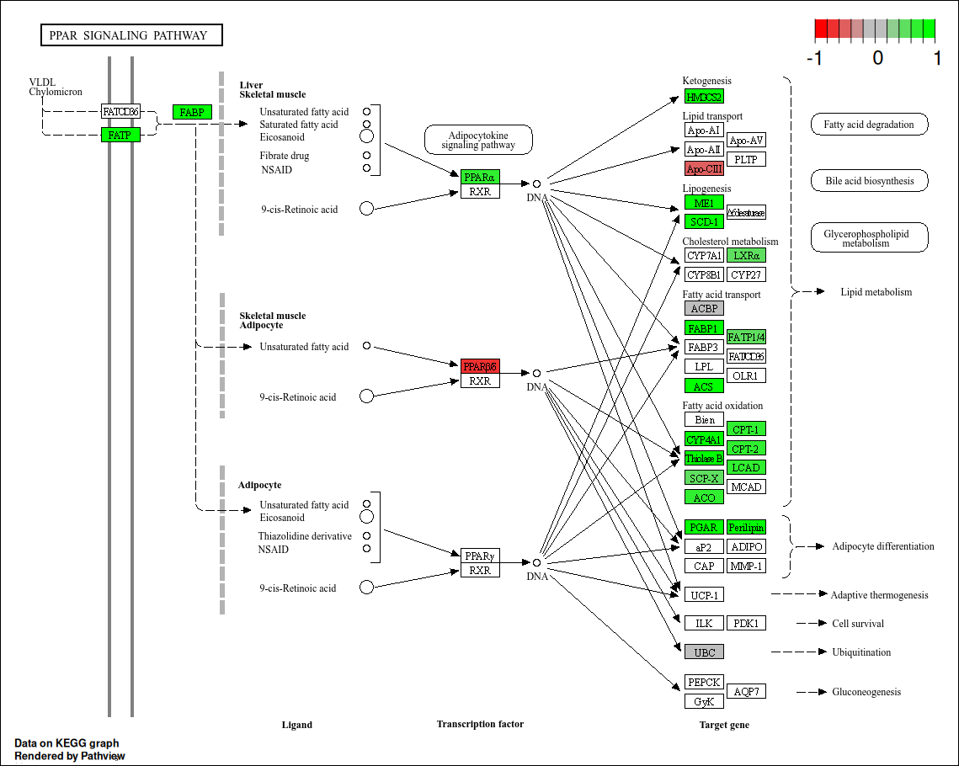

Slide 24
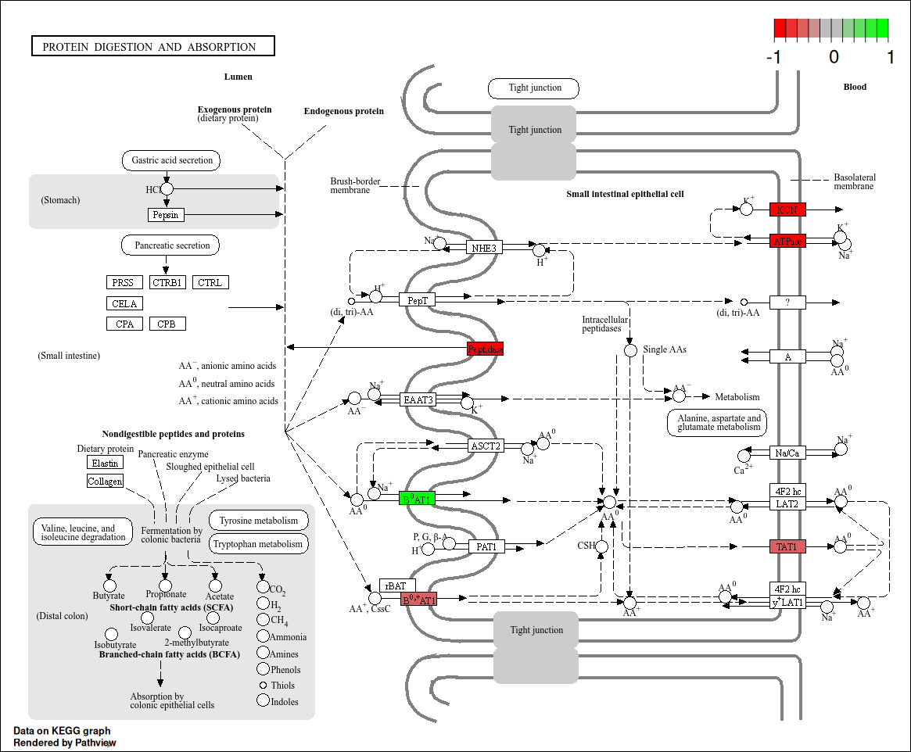
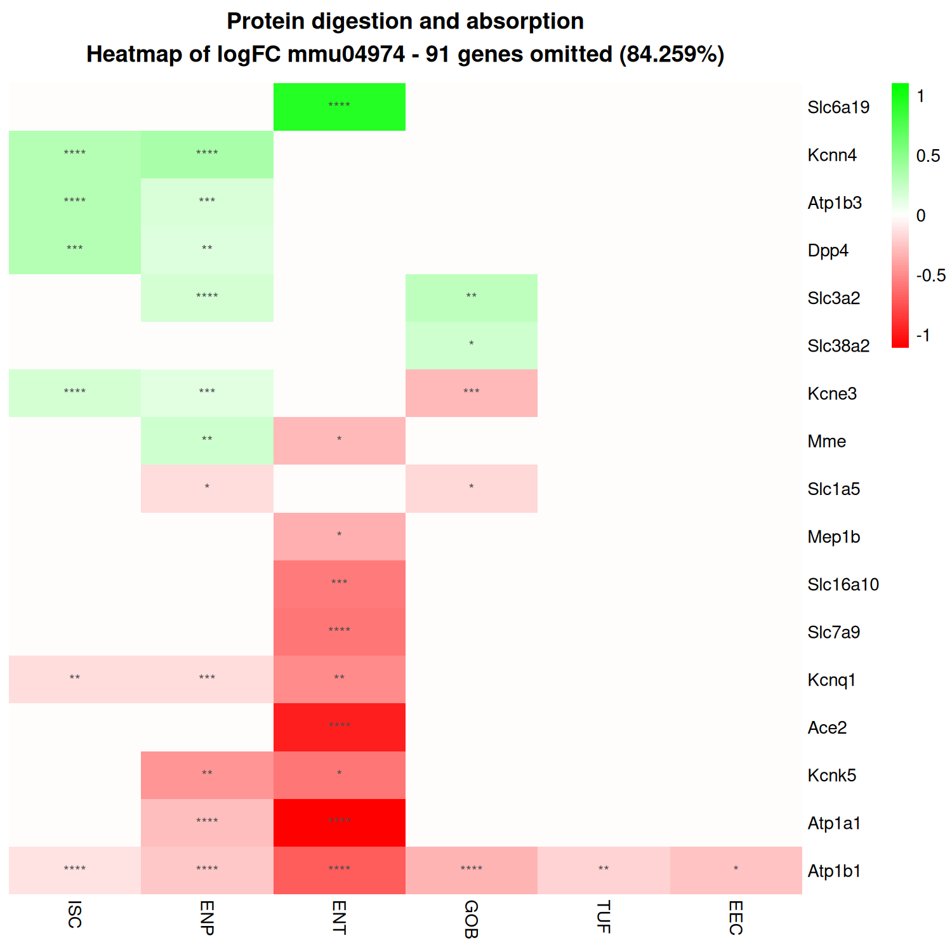

Slide 25
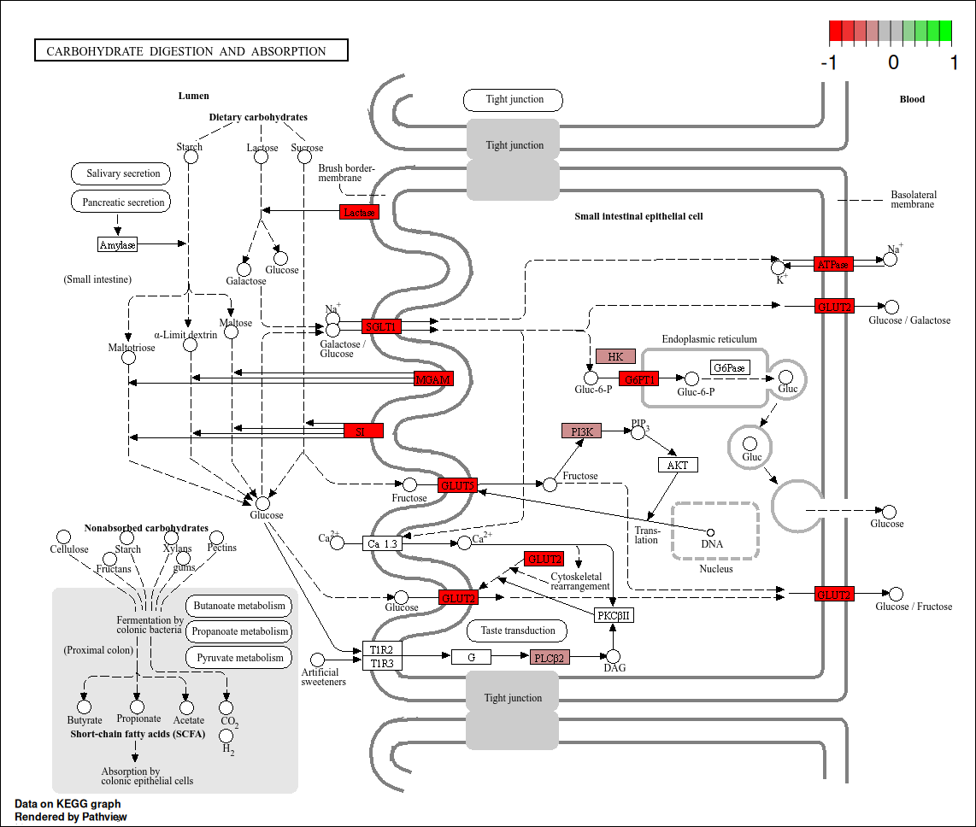
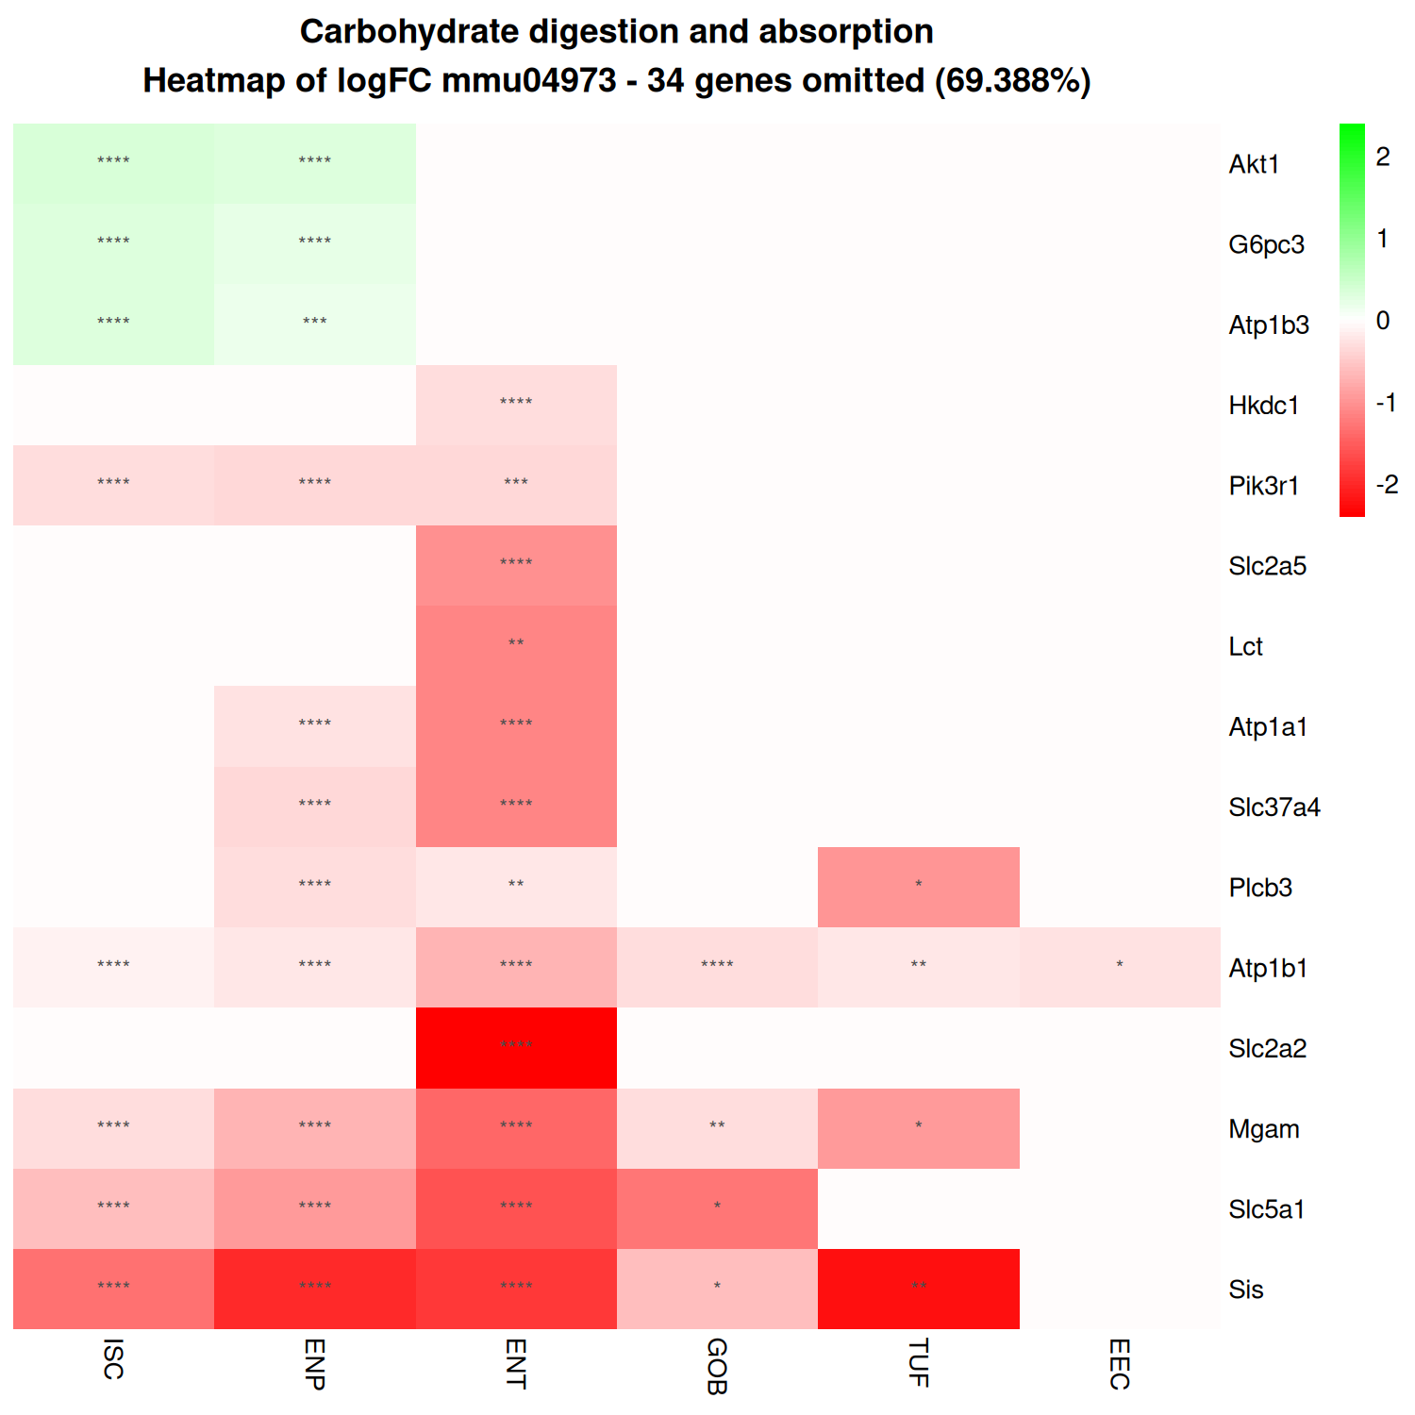

Slide 26
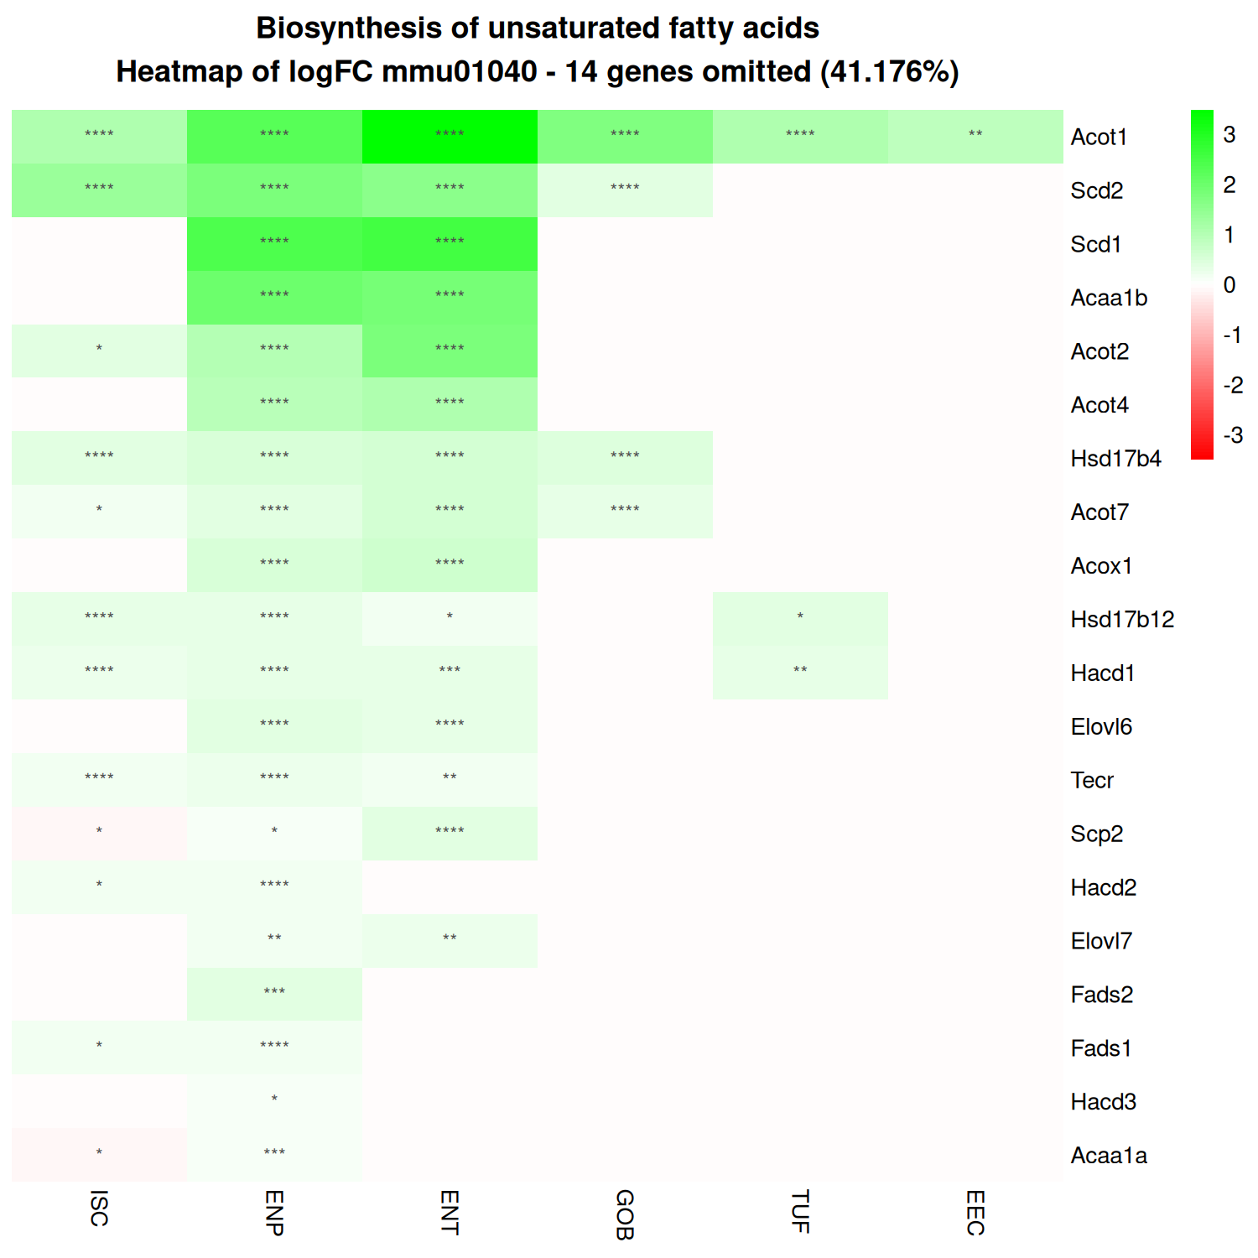
Error Loading KEGG Graph

Slide 27
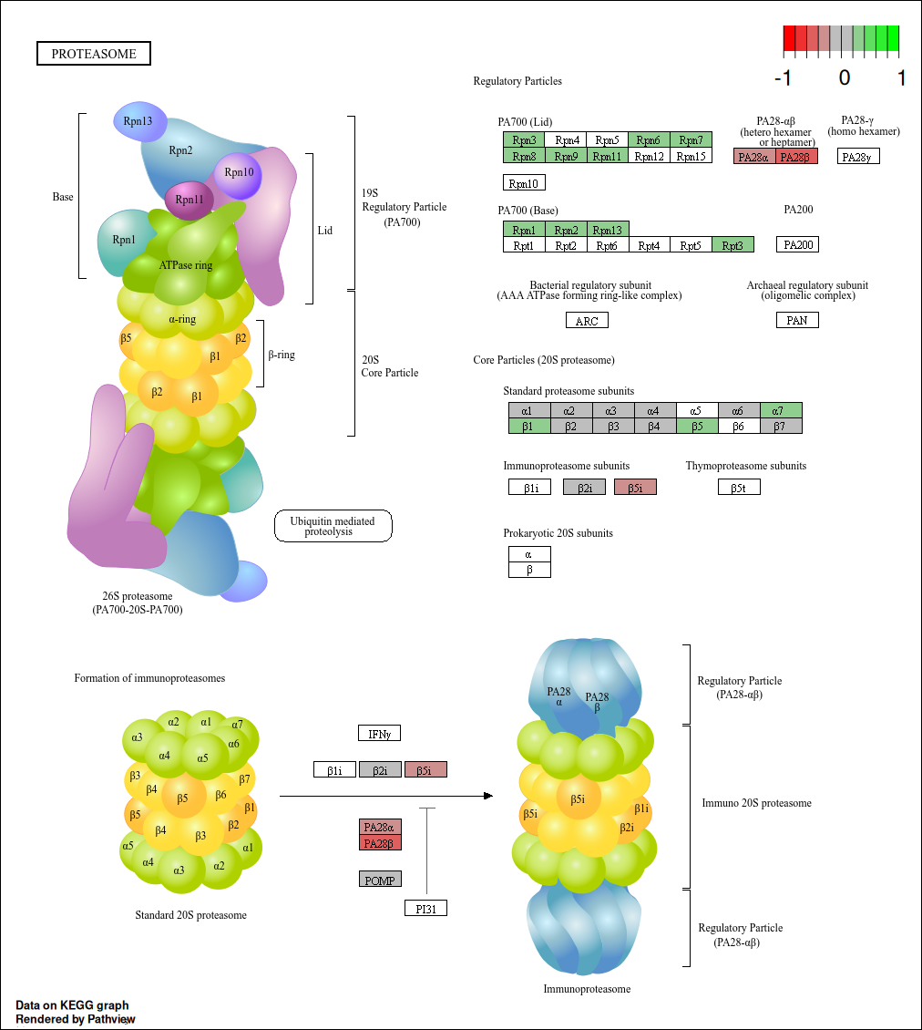
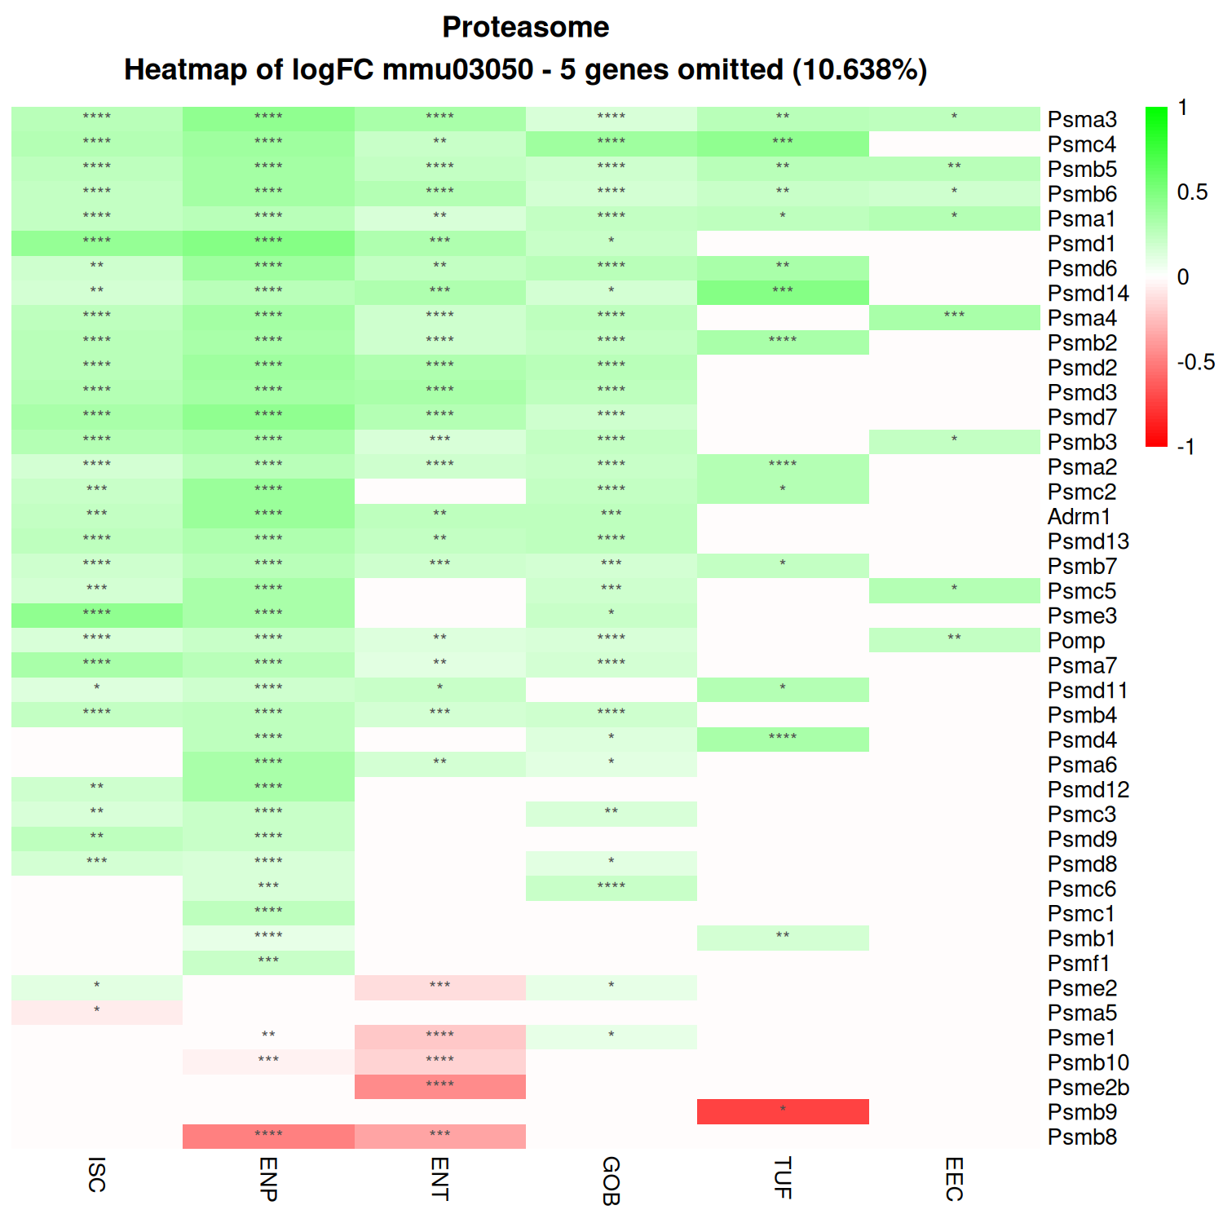

Slide 28
Intestinal Stem Cell Pathway Analysis

Slide 29
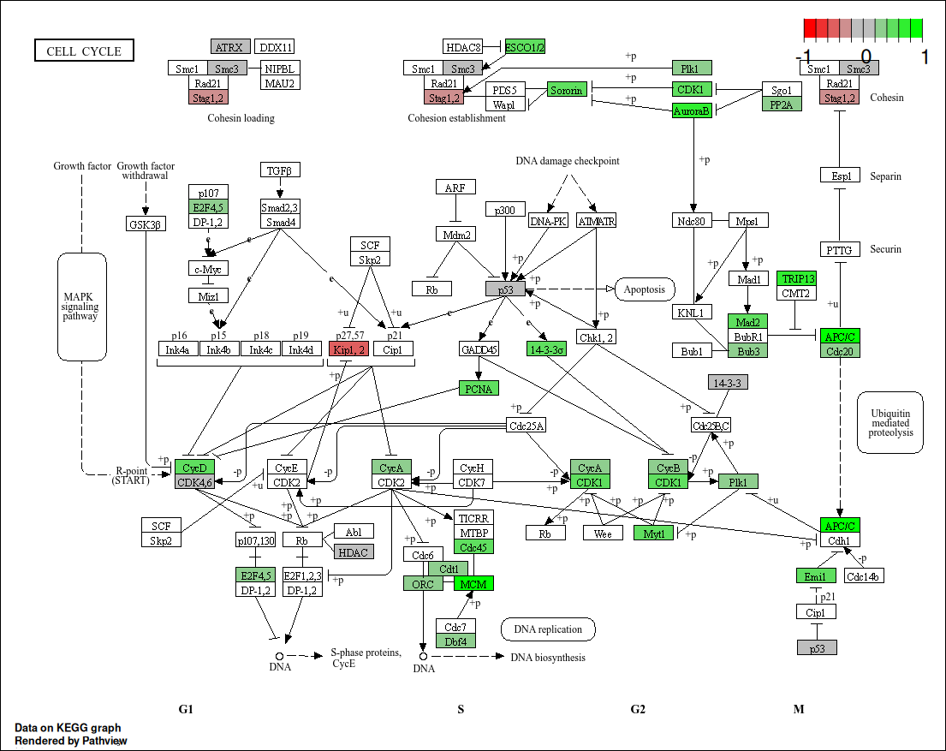
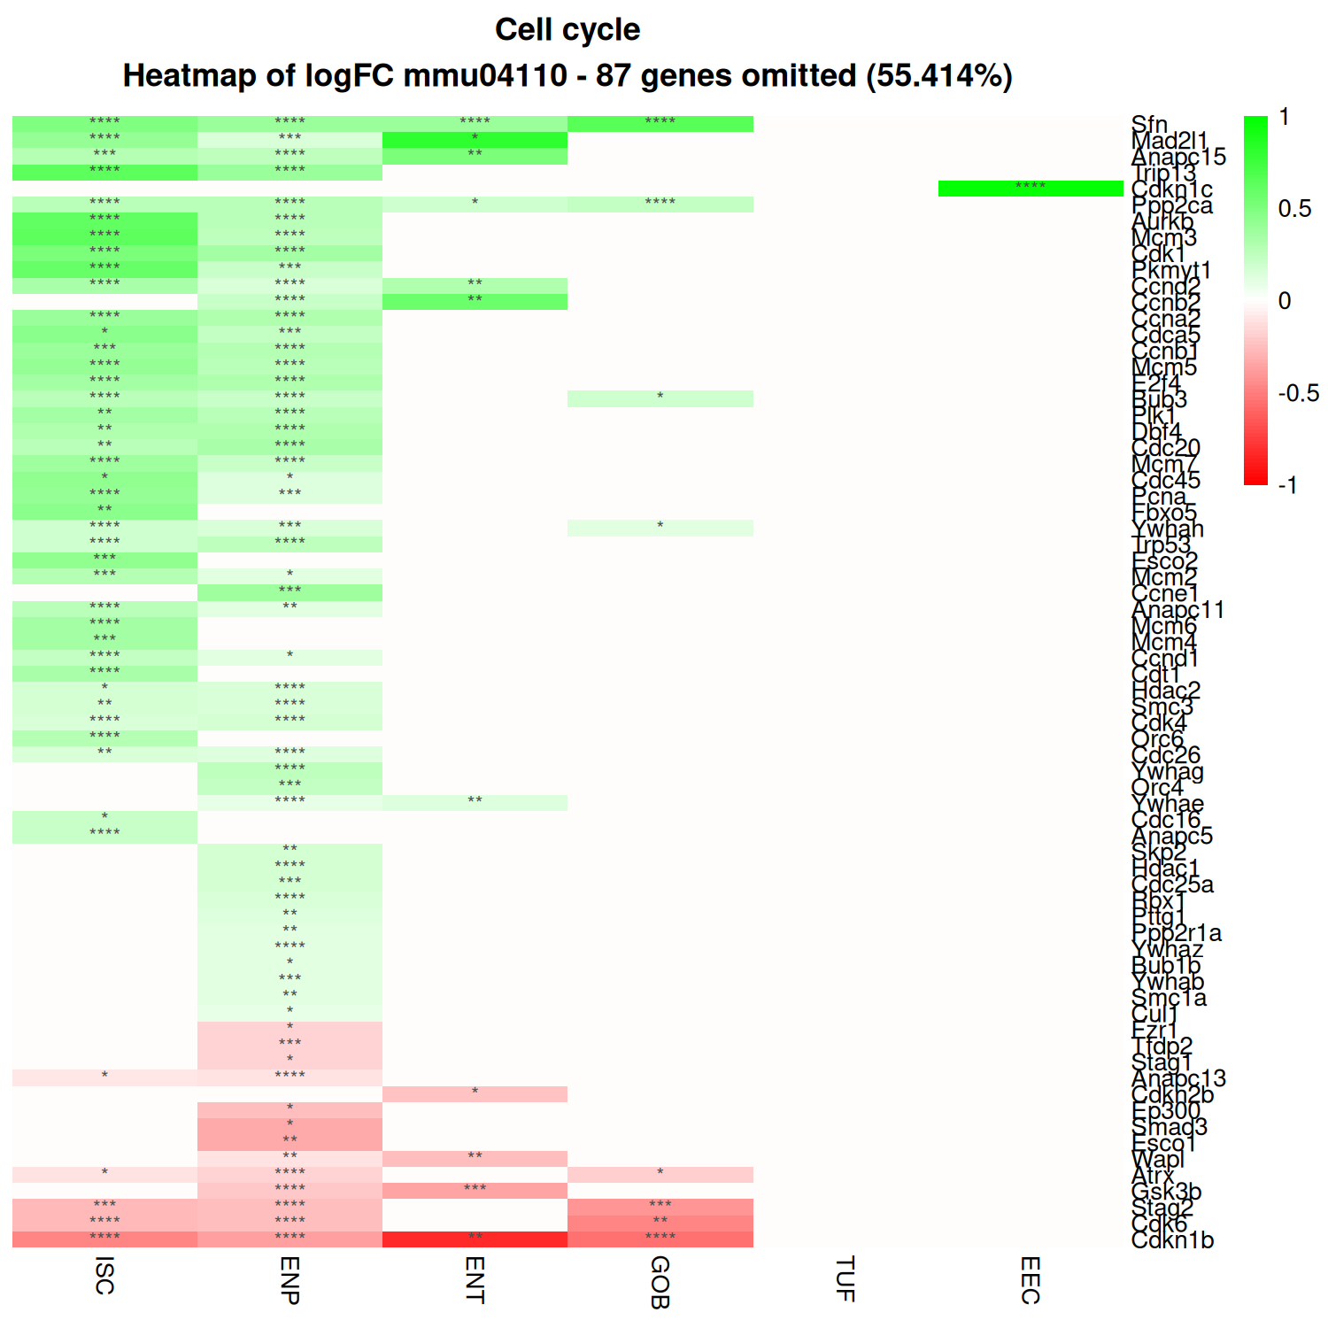

Slide 30
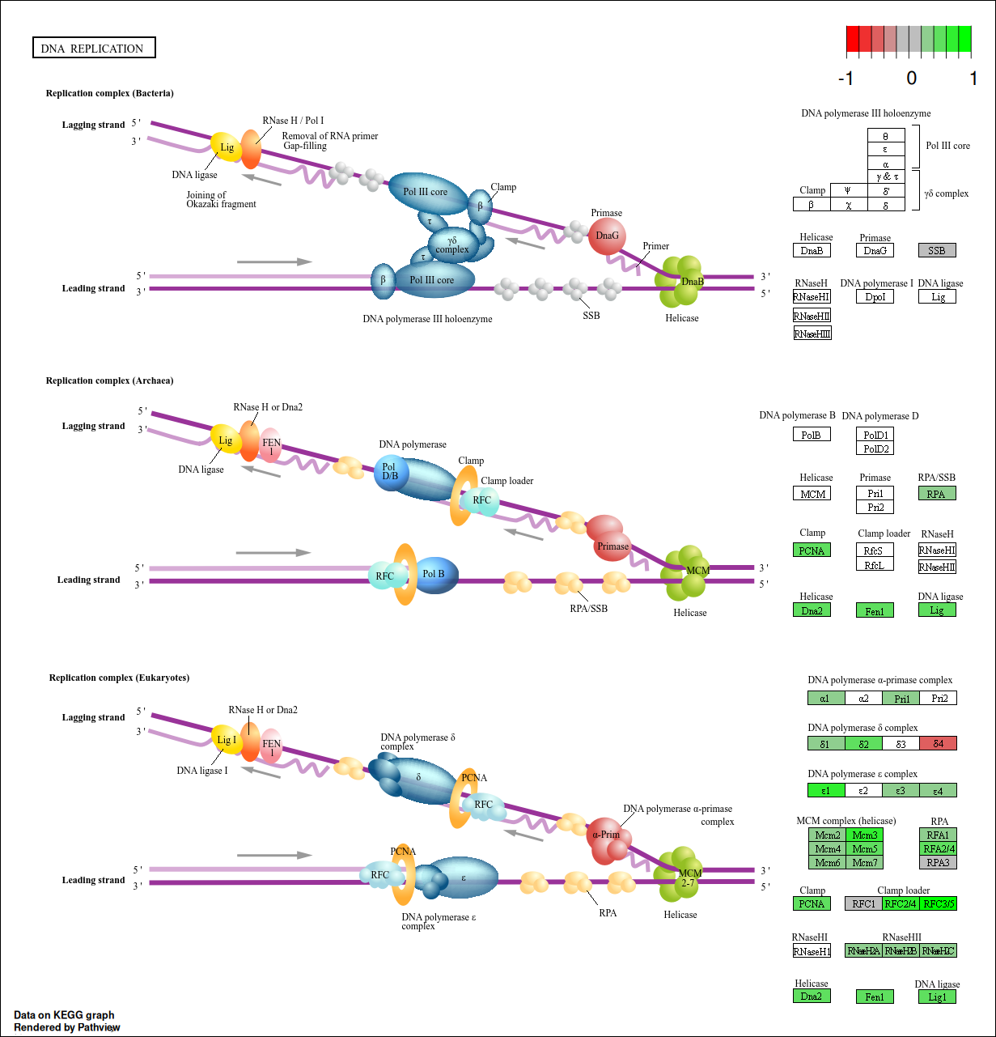
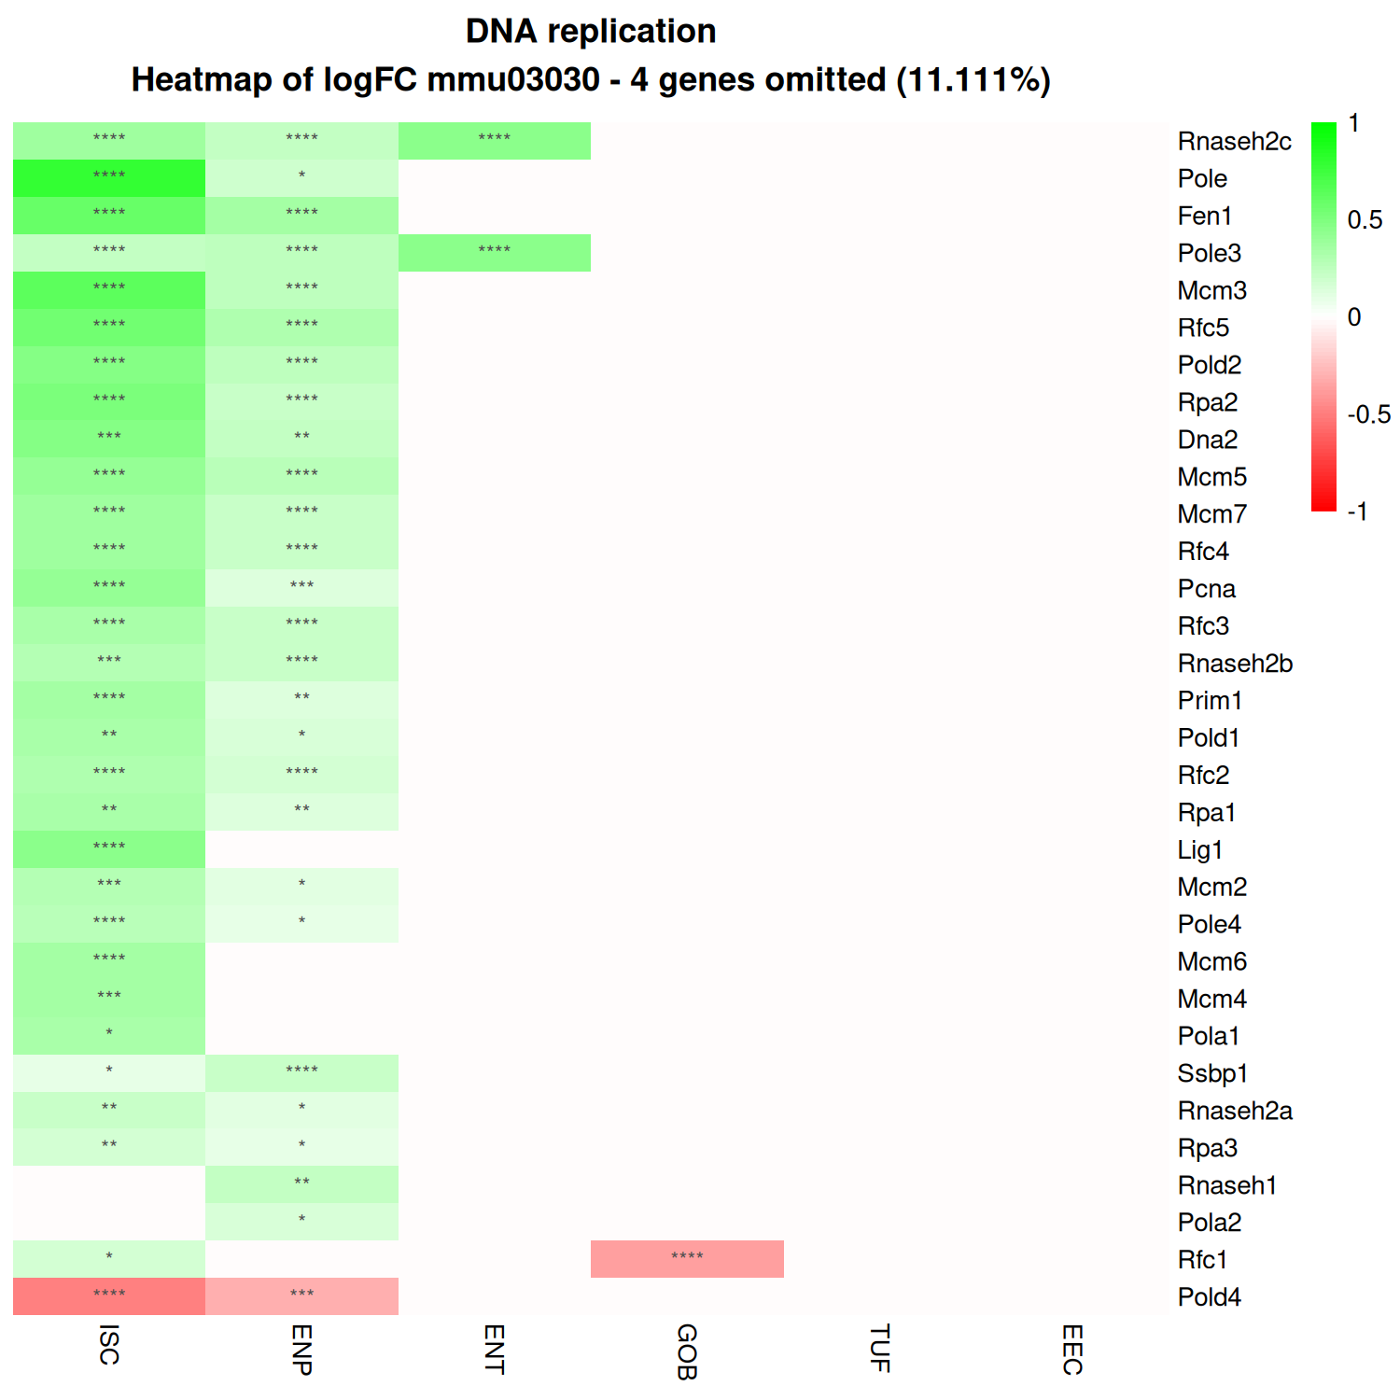

Slide 31
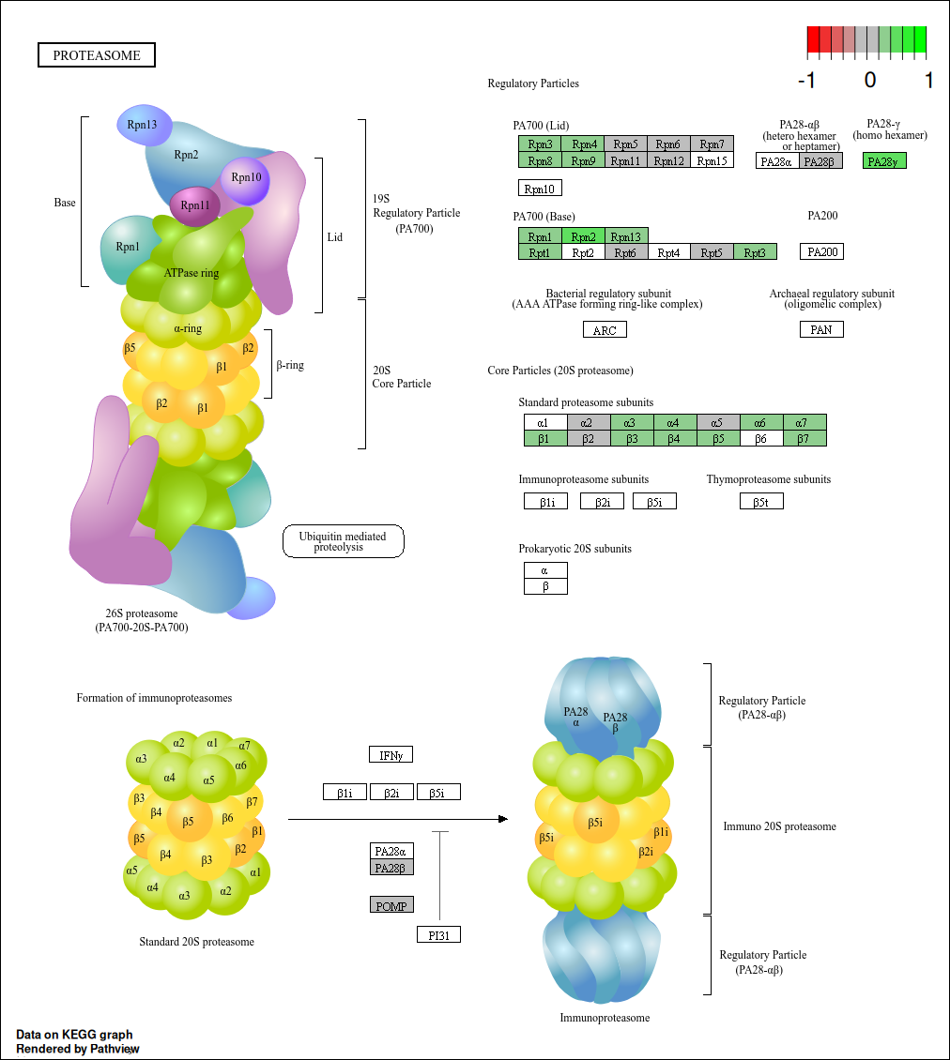

Slide 32
Goblet Cell Pathway Analysis

Slide 33
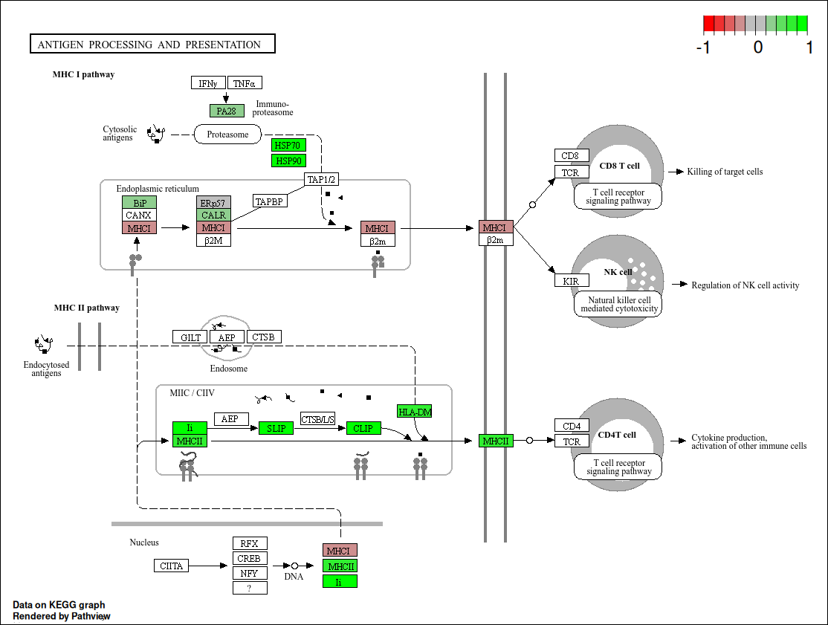
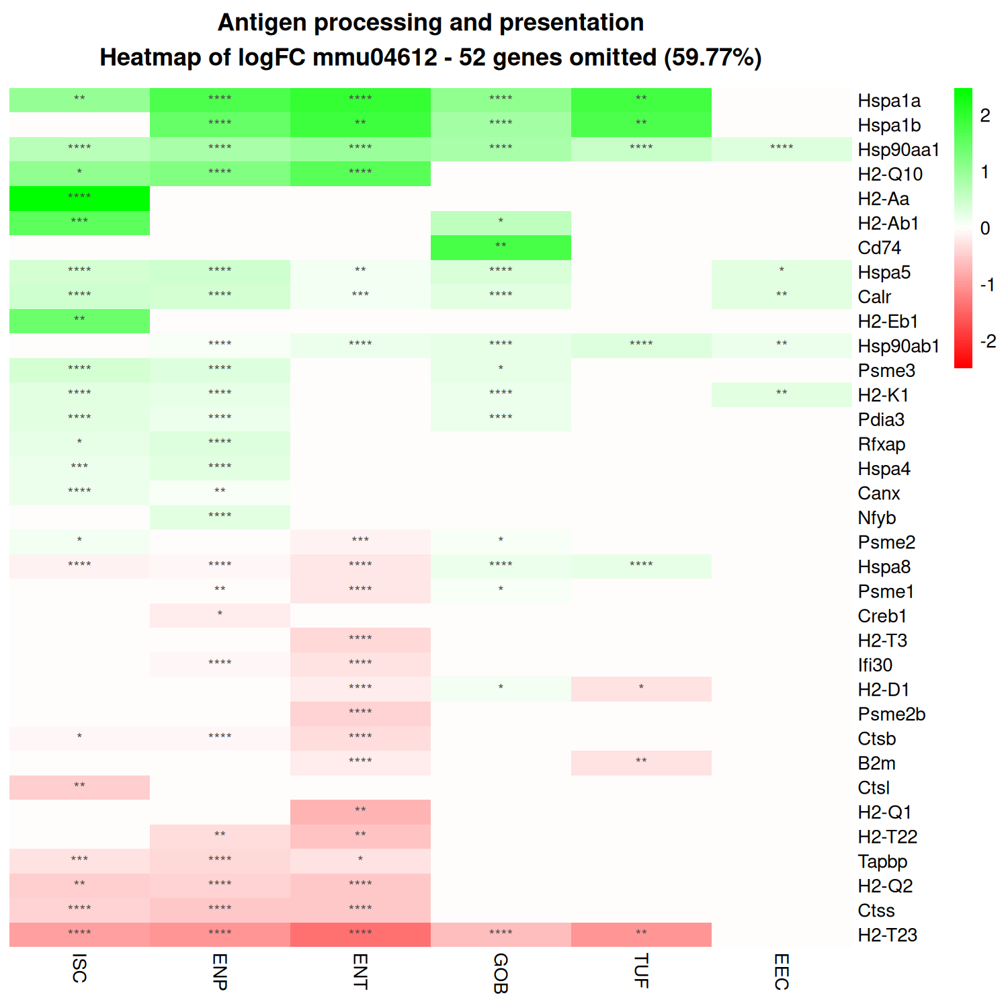

Slide 34
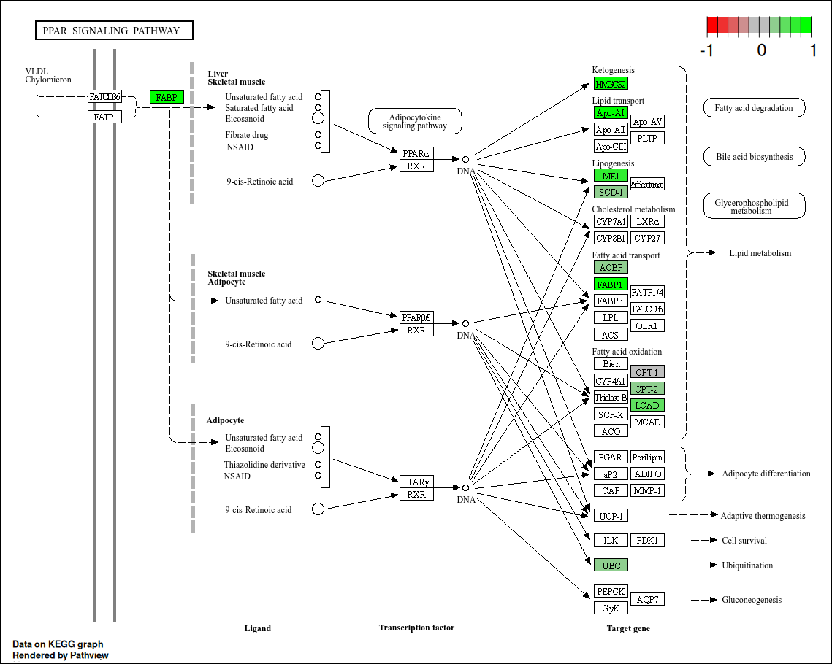

Slide 35
Metabolism Pathway Analysis

Slide 36
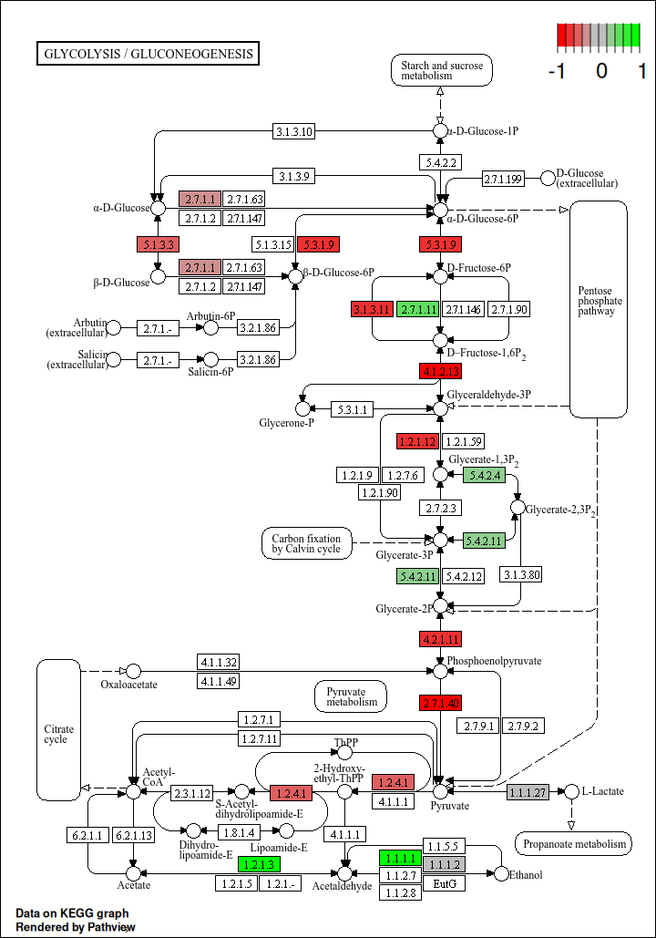
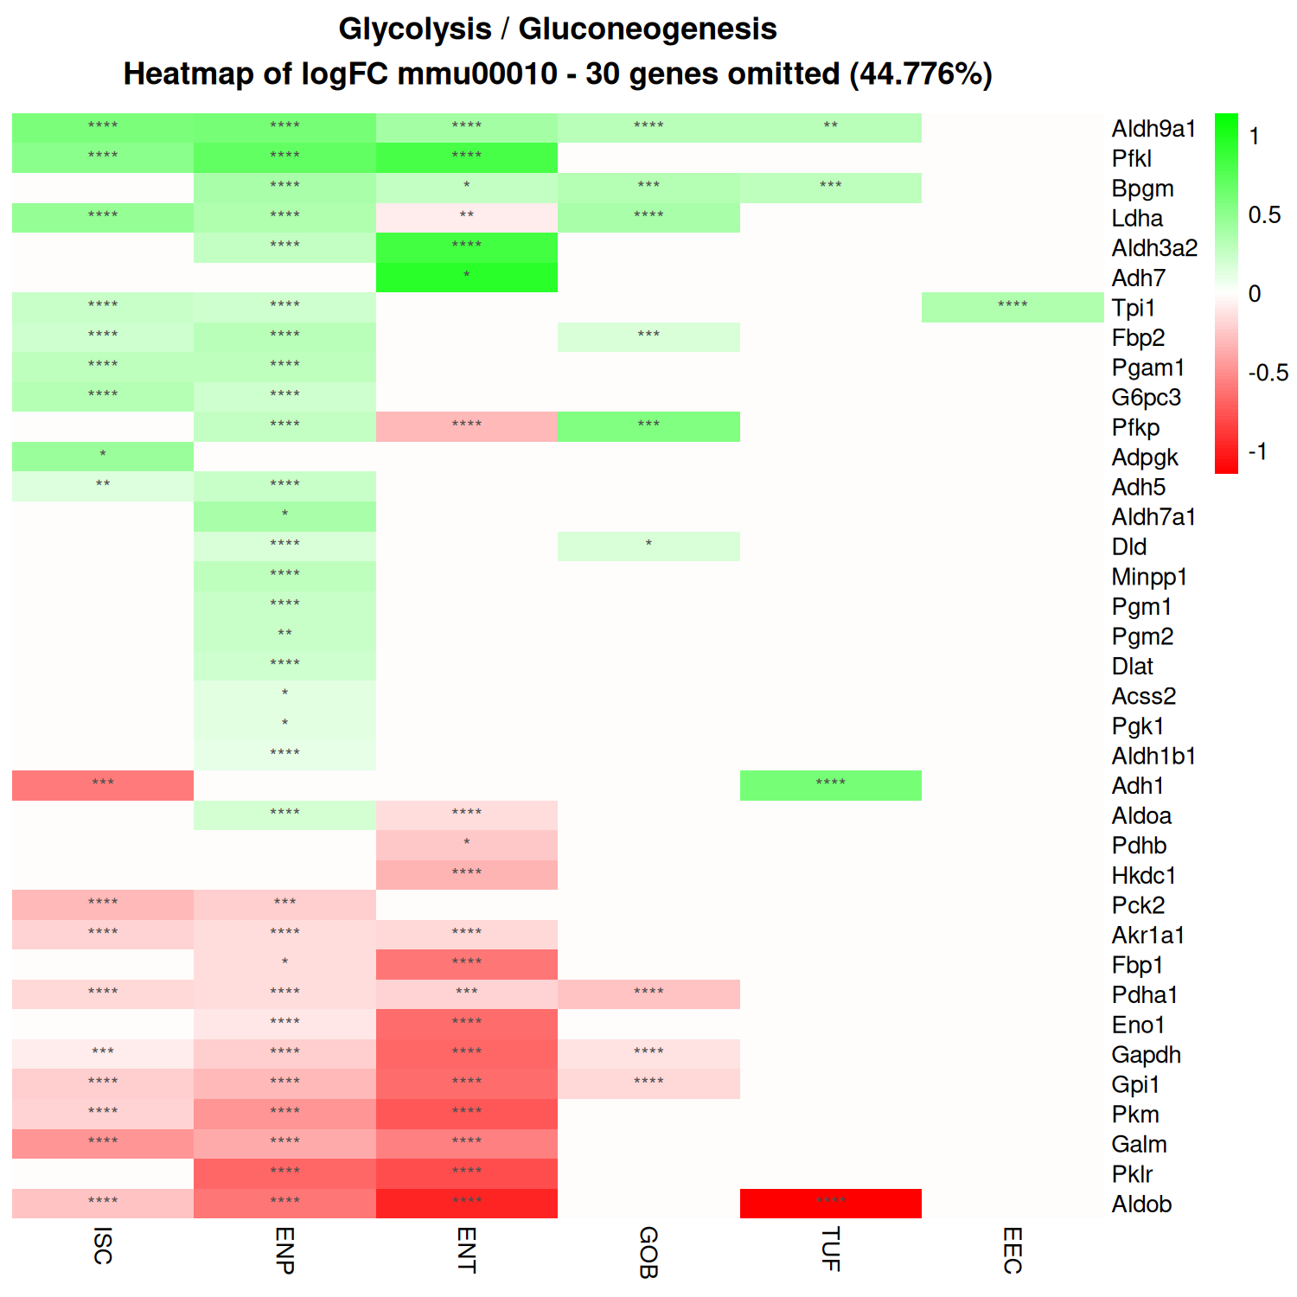
Enterocytes

Slide 37
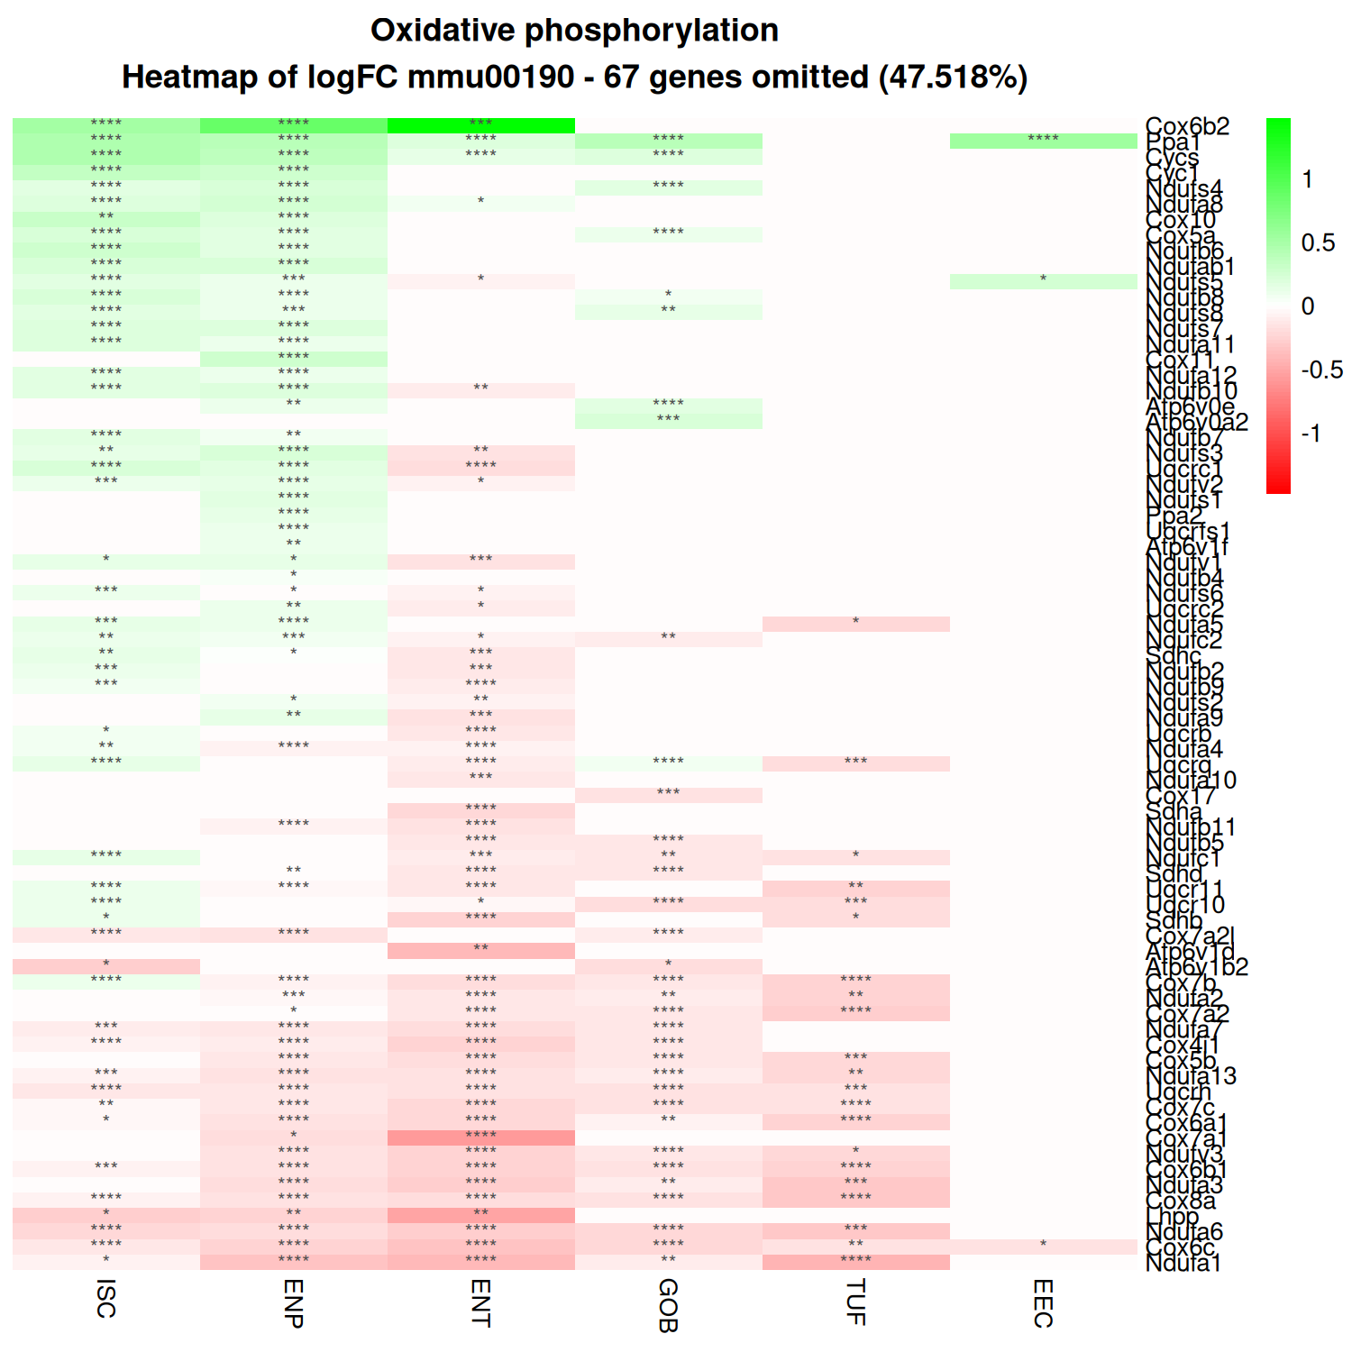
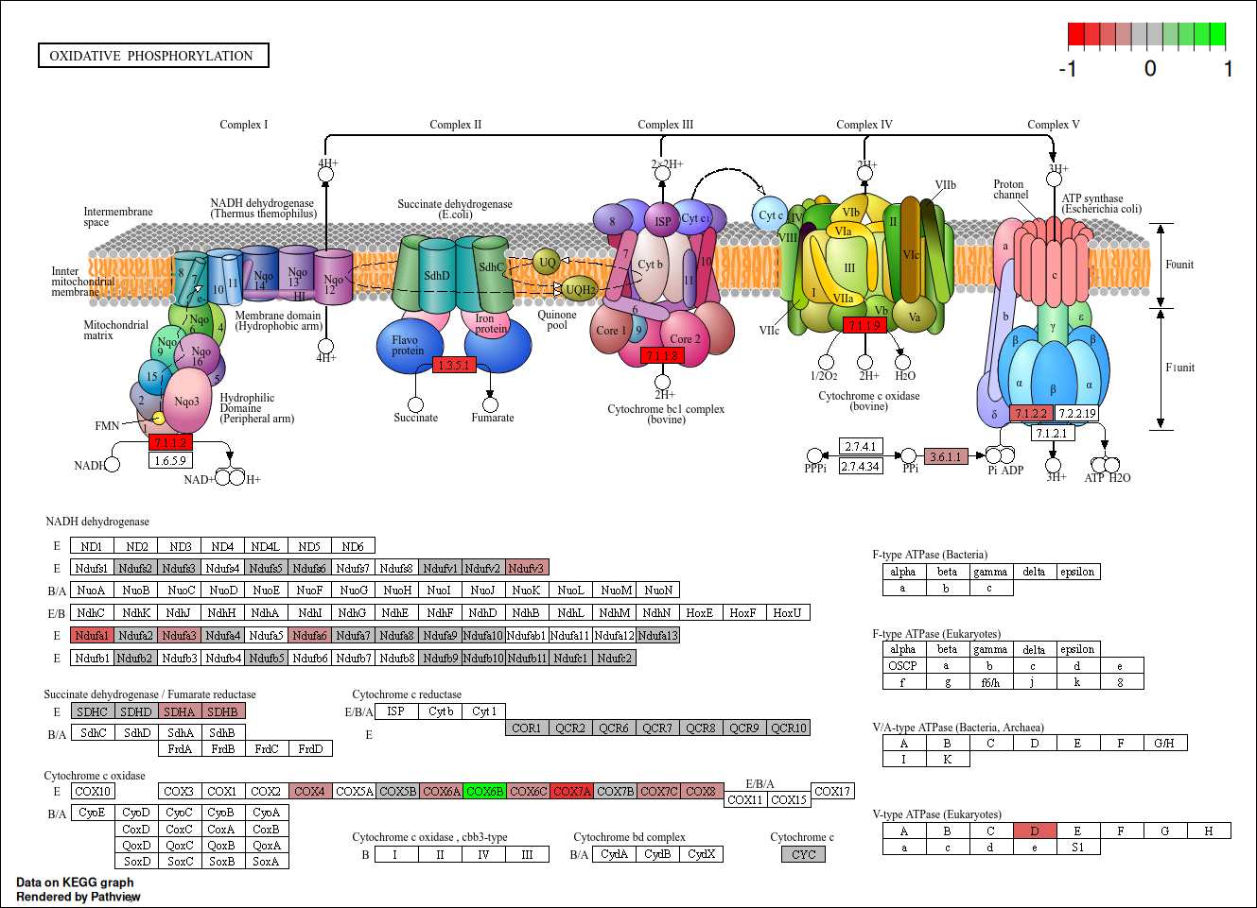
Enterocytes

Slide 38
Protein Folding/Degradation Pathway Analysis

Slide 39
Enterocytes

Slide 40
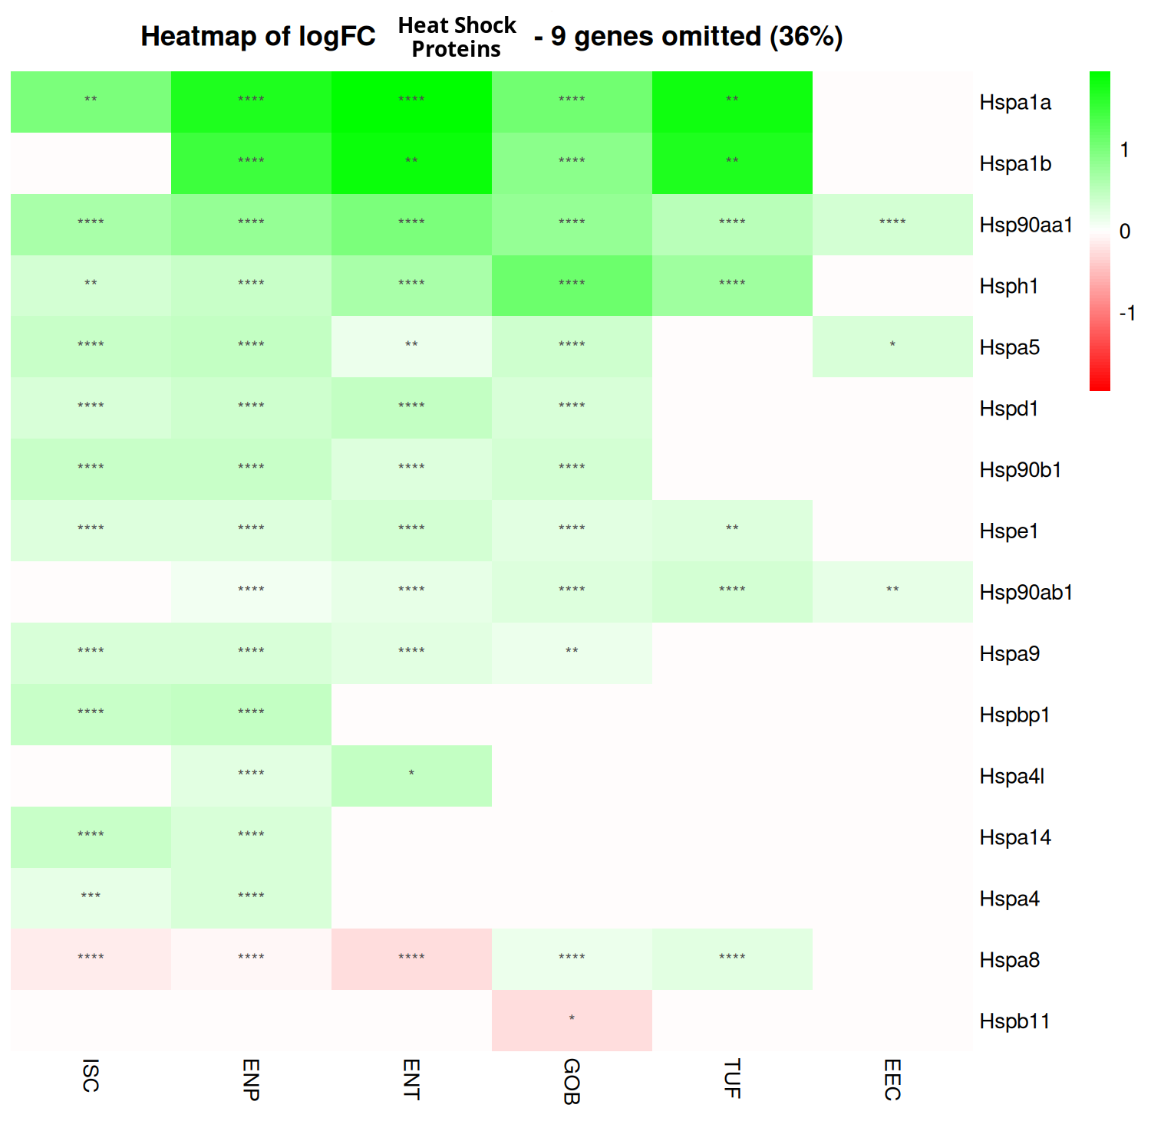

Slide 41
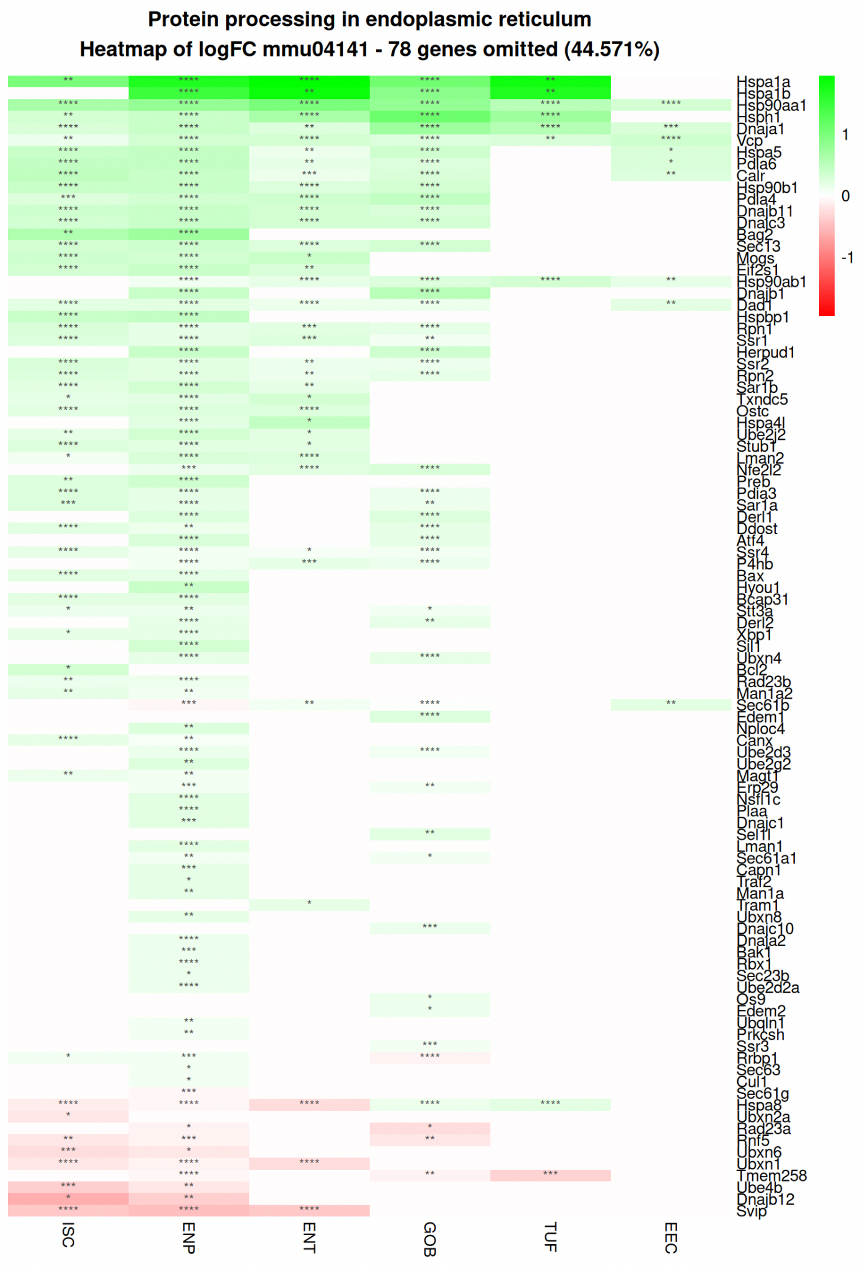
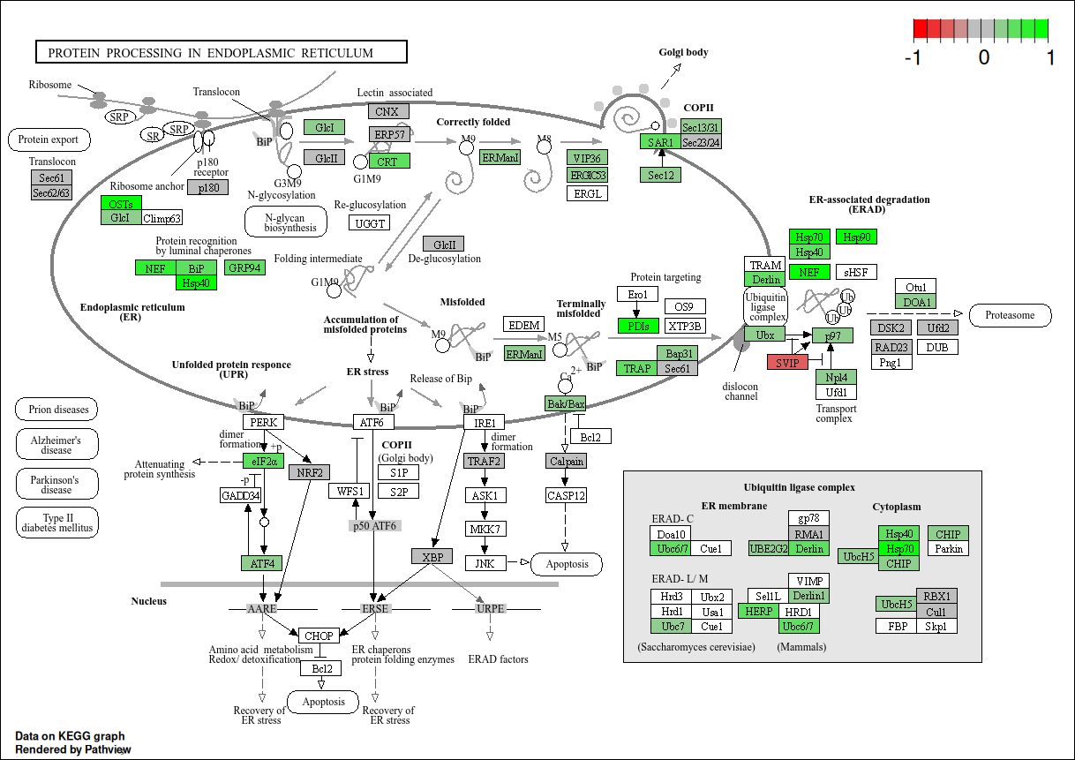
Enterocyte Progenitor

Slide 42
Barrier Function Pathway Analysis

Slide 43
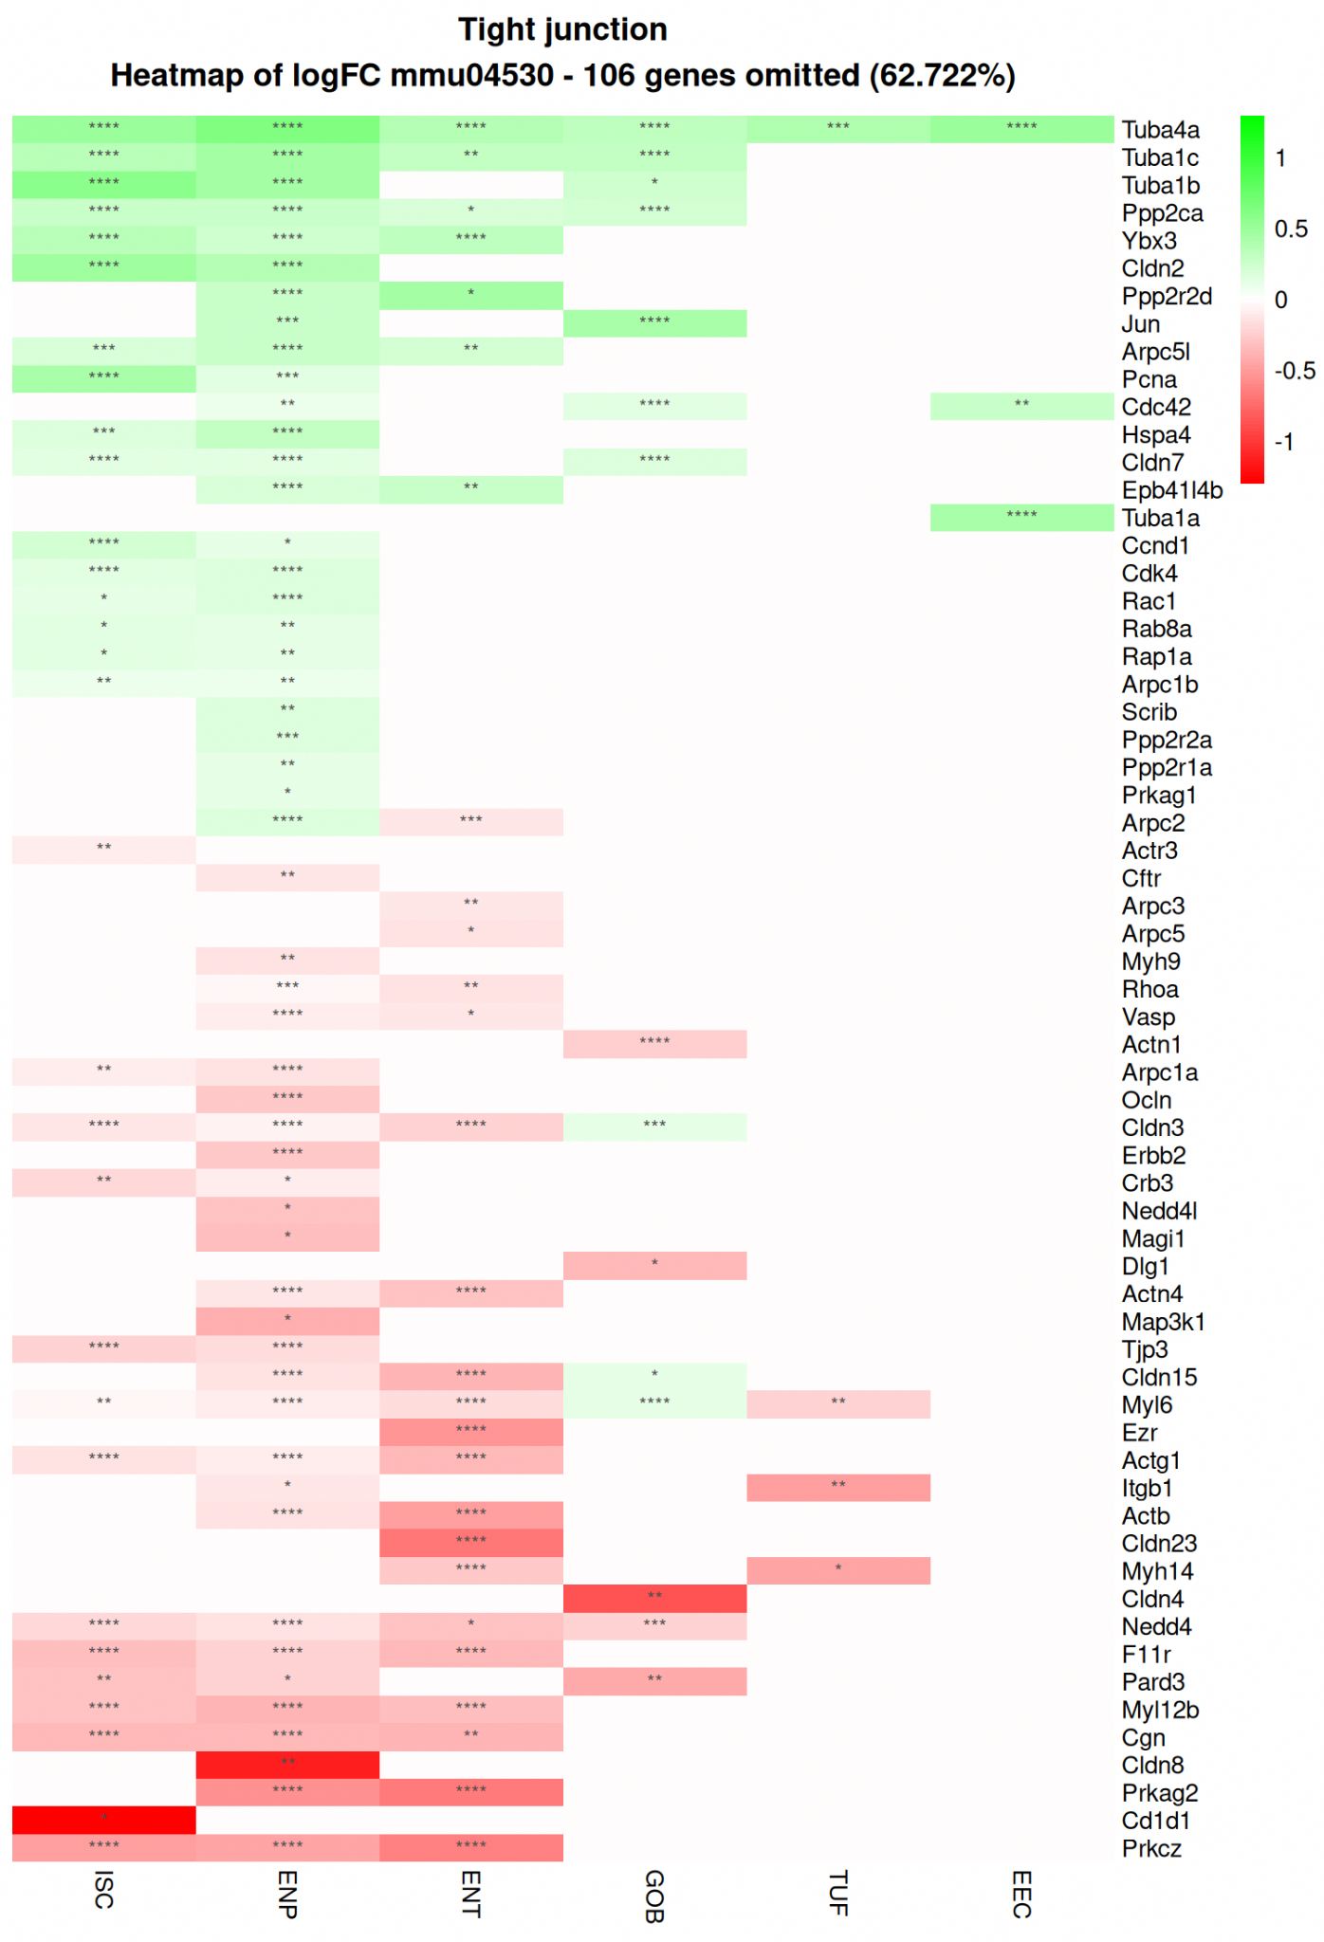
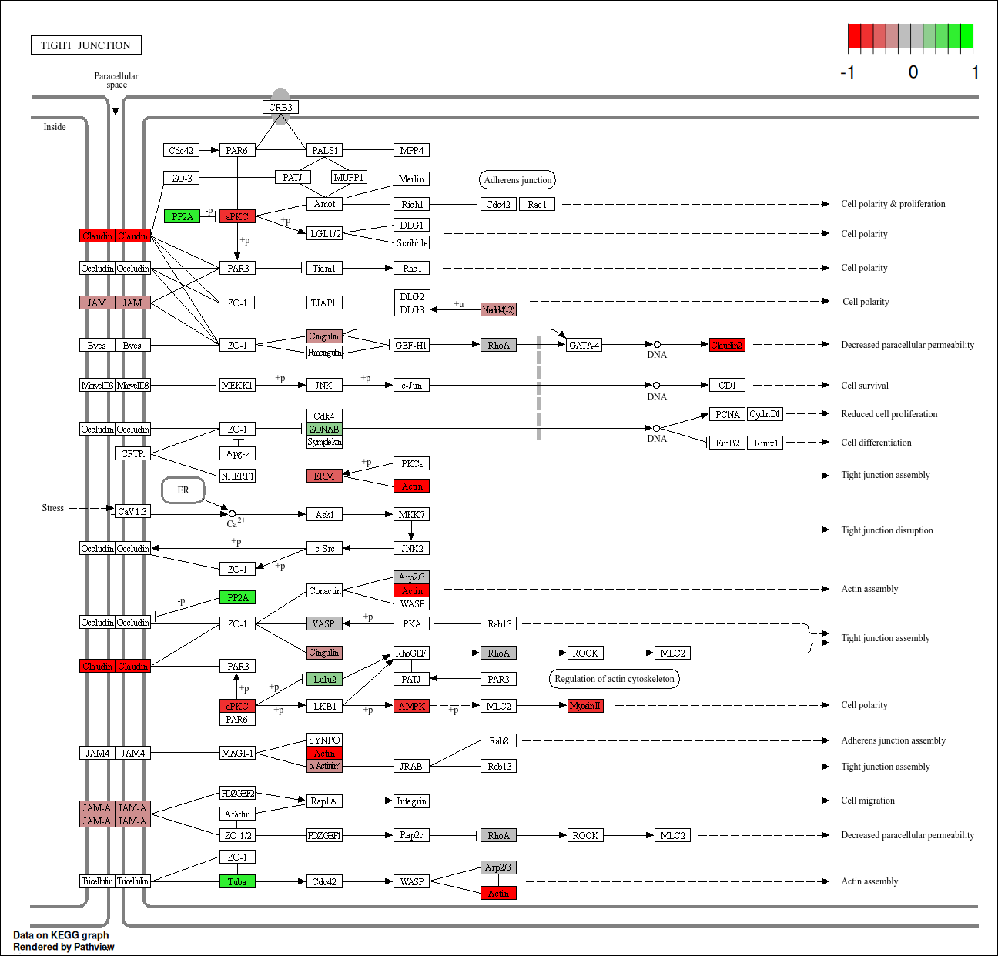
Enterocyte

Slide 44


Enterocyte

Slide 45


Enterocyte

Slide 46


ISC

Slide 47
Inflammation Pathway Analysis

Slide 48


Enterocytes

Slide 49


Intestinal Stem Cells

Slide 50


Enterocytes

